Slide 1




Data Stream Affinity Propagation
for Indoor Space Localization Data
Nasrin Eshraghi Ivari
Department of Geodesy and Geomatics Engineering
University of New Brunswick
May 5 2021
Notes:
Today iam going to talk about my research work on data stream clustering and introduce a new algorithm for indoor loca data

Slide 2
Outline
Introduction
Previous Research Work
Methodology
Experiments
Results
Conclusion and Future Work
Notes:
during the presentation I will go through
Introduction of the subject
Then the Prevois research work had been done
also I will talk about our method
then I will Introduce 2 experiment we used
Next, result,
and finally conclusion and future work

Slide 3
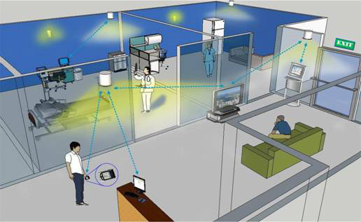
Introduction
Data streams are real-time, continuous, ordered series of data points coming at a very high speed.
They are generated by indoor localization systems in indoor spaces.
Fizmon(2016)
Motivation
The stream data points generated by indoor localization systems require stream clustering since they are a sequence of potentially infinite, nonstationary data arriving continuously where random access to the data is not feasible and storing all the arriving data is impractical.
Notes:
What is data stream
Well, many systems generate observations continuously and in real time which is called data stream.
For example, infrared sensors used in indoor loca systems generate thousands of observations each second.
For such a datastream, clustering and finding pattern is required, because they are infinite and random access and data storage are not possible
_____________________
mostly These applications track objects in an indoor environment
(2)A more suitable approach is to update existing clusters and integrate new observations into the existing model by identifying emerging structures and removing outdated structures incrementally. This is the goal of stream clustering where data points are assumed to arrive as a continuous stream of new observations
--------------------------------------------------------
Due to the infinite nature of data streams, it is impossible to store all these data in memory or even in disk, so we have the constraint of a single pass over the data, typically upon their arrival. That is, once an object has been processed, it cannot be processed again(not random access), Finally, the system has no control over the order in which data objects arrive. Typically, the objects are assumed to arrive independently of each other.

Slide 4
Introduction
Affinity Propagation (2006)
Partitioning message passing clustering algorithm
Determine the optimal number of clusters for the user
Algorithm stops when convergence is achieved
Suffer from high memory complexity
Motivation
The affinity propagation (AP) algorithm has been chosen for analyzing indoor localization data streams since every data point teats as a potential centroid, also, it does not require the number of clusters as an input.
Notes:
Stream Clustering is an unsupervised machine learning technique.
And There are different types of clustering methods are available. The affinity propagation algorithm or (AP) has been chosen for this work.
AP is a partitioning message passing algo . It means, all data points are potentially cluster centroids and they send messages between all data points to find final cluster centroids.
We have chosen AP because, cluster centroids of this algo are true representative of the location. Also, this algorithm doesn't require to specify the number of cluster before running the algorithm.
Actually This algo suffers from memory complexity which means it cannot handle a very large datasets
_______________________________________
. It means to find a data points with the maximum similarity to others
All these techniques have different approach for clustering.
for example Find mean out of the data or find pattern out of the density or fit the model and some of them have a random access to data.
operating automated operation more robust

Slide 5
Introduction
Streaming clustering is important for:
Occupant Behavior
Building Management Information Systems
Emergency
Building Accessibility Studies
Advertisements
Motivation
The streaming cluster analysis was aimed at finding any evolutionary patterns and requires a process capable of partitioning the data streams continuously while taking into account restrictions of memory and time.
Notes:
Stream clusteing is important in many indoor cases such as
to improve management decision like to Control the temperature of the building and where to install AC
Another example can be advertising a product, and where to install a billboard or screen to have higher viewers, and where is the most crowded space
a very important example in these days is to control the spread of COVID-19 in public places such as malls and monitoring the human mobility to keep social distancing, and keeps the limit number of people inside.
For all these kinga application, finidind a meaning out of these infinite data is very important and it is possible by stream clustering analysis
______________________________________
Also Using people counting data allows you to optimise the space you do have through either progressively filling certain areas of the building to ensure occupancy capacity is utilised to its full potential.
hence its ability to handle large data sets diminishes rapidly with size and cannot
handle massive data sets. However, for clustering data streams which are small
data depending on the data rate and the time interval of the time window used for
the clustering, a streaming AP algorithm becomes a viable solution for clustering
IoT data streams such as the indoor localization data streams.
Due to the infinite nature of data streams, it is impossible to store all these data in memory or even in disk

Slide 6

Research Problem
Processing the fast incoming data streams with traditional clustering techniques is not feasible.
Variations in the underlying data distribution due to the evolution of the clusters over time is difficult to capture.
Notes:
We were faced 2 problem for clustering indoor loca data.
First, processing the fast incoming data streams. it is not possible to store and analyze the data streams based on an offline mode. So, we had to solved large-scale issues,
The second challenge was related to data distribution due to the evolution of the clusters over time.
___________________________
These models aim to handle the evolution of the distribution of the data stream over time. Applying a time window
makes it possible to analyze and store a stream within a specic time frame and discard the previous historical data
Most clustering algorithms require a fixed size of data and evaluate each point many times to generate the clusters.
in this case we have 2 option for cluster data stream (1) for new data point shift cluster, then classical clustering algorithms need to be run periodically(computationally expensive and requires that all relevant data is stored)
Due to the innite nature of data streams, it is impossible to store all these data in memory or even in disk

Slide 7
Research Objectives
Develop a new data stream AP model (DSAP) based on an online micro-cluster phase and offline macro-cluster phase
Apply the landmark time window model to continuously accumulate sufficient data points for computing the micro-clusters
Evaluate the clustering results using performance and validation metrics
Demonstrate the potential of DSAP for analyzing localization data streams
Staircase usage patterns
Occupant behavior in indoor spaces
Notes:
The goal of this research work was to
Develop a new data stream AP model or (DSAP) based on online and offline phases
Also , Apply the landmark time window model to accumulate data points for generating micro-clusters
Then , Evaluate the results using performance and validation metrics
And finally show how well DSAP is for analyzing localization data streams for two experiment:
To find Staircase usage patterns
And Occupant behavior \
Both for indoor spaces
.

Slide 8
Previous Research Work
Localization technologies have been explored for generating location data of people in indoor spaces, including Wi-Fi. In particular, infra-red, break beam, thermal, and sensors have been used for counting people in indoor spaces.
Previous research work applied the AP partitioning-based method for improving indoor fingerprinting using Wi-Fi RSS data.
There are a few robust streaming algorithms based on the AP method.
To the best of our knowledge, streaming AP algorithms have not yet been applied for clustering e-counters and Wi-Fi location data generated in indoor spaces.
Notes:
Previous research work shows that AP clustering algo is applied for finding clusters of wifi rss at the university campus(received signal strength)
There are few streaming AP algorithms are existed.
But non of these algorithms have been applied for clustering people-counters and Wi-Fi location data in indoor spaces.
.

Slide 9
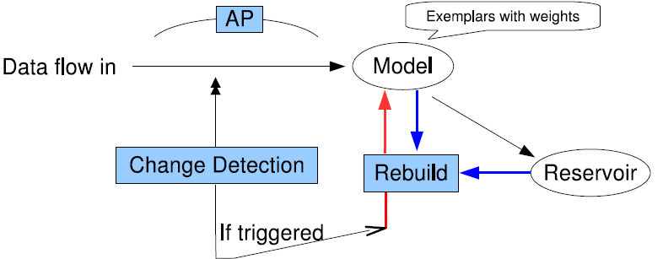
Previous Research Work StrAP Algorithm
A first batch of data stream data points is selected(user-defined) and the first cluster-centroids are obtained using AP
Two restart procedures (reservoir filling up or the Page-Hinkle test)
Rebuilt by launching a weighted version of AP
Notes:
The first streaming ap algo is Strap . This is an online algorithm with using sliding time w model.
This algorithm starts with The bunch of data and applying AP to compute the first centroids
2. As the stream comes in to the model, each data point is compared with the centroids. If too far from the nearest exemplar is put into the
reservoir, else the stream model is updated
3. Strap has 2 The restart criterian. First when the reservoir become full,
And second when the data distribution has been change
If each of these 2 happens, the stream model is rebuilt
_____________________________________
from the current exemplars and the reservoir, using WAP again
This comparison is carried out by computing the Euclidean distance of xt, ei with the threshold , which is a heuristically set,
and the value is equal to the average distance between stream data points and
centroids in the initial step.
WAP → select the latest centroids
.

Slide 10
Previous Research Work Summary of Streaming AP Algorithm
Algorithm | Year | Processing | Time Window | Specification
StrAP | 2008 | Single-pass | Sliding | * Not robust in terms of outliers * Computational time is high
IStrAP | 2012 | Single-pass | Sliding | * Eliminate outliers * Calculate the standard deviation * Remove data outside the boundary
ISTRAP | 2018 | Single-pass | Sliding | * Cluster disappearance * Cluster re-occurrence * Four parameters are needed to monitor the process
APDenStream | 2013 | Online-offline | Sliding(online)/ Pyramidal(offline) | * Based on AP and density methods to improve StrAP * Computationally high The Decaying Function Tuple decay density Micro-cluster decay density Micro-cluster synopsis structure
Notes:
In addition to strap, 3 more ap stream clustering algorithms are existed . These algorithms were inspired by strap with some differences in the update strategy.
All these 4 models used sliding time w model
IstrAP
The first istrap algo has a mechnism to eliminate outliers by using standard deviation but it is work well just for normal distribution and previous researches show that this is not a robuts method for detecting outliers
The second ISTRAP is another algorithm introduced in 2018. This method has 2 more types of judgement To update clusters .which are disappearance and reoccurance. This method requres many parameters to be set for the user. This algo has a high performance than strap but it is not efficient in terms of time and memory consumption especially for keeping very old clusters
APDenStream is the only online offline method has been introduced for ap streaming methods. This algo combined strap with density based method to find a dense clusters. But this approach is computationally high especillay because of defining decay functions and having different data structure
The proposed method in this work is a simple version of all these algorithms
For example the proposed algorithm avoids the computation to detect the re-occurrence, and disappearance of clusters to avoid adding any extra costs
Also we used landmark which non of the previous work used this type of window
Also,the programming codes of these algorithms are not available, except STRAP.Due to all these reasons were proposed
----------------------------------
Unlike some of the other algorithms that require tuning
several parameters to capture the current state of the model, DSAP uses a simple
combination of autonomously calculated dynamic threshold and expiration time to
keep the algorithm more ecient.
cluster disappearance refers to an existing cluster that is
not visited by any recently arrived data points. Cluster re-occurrence occurs when
a previously disappeared cluster reoccurs at a later timestamp.
STRAP method with a particular cluster evolution tracking, we propose
Weakness of all :
Our focus is on designing a novel update strategy for the clustering process, allowing a streaming AP algorithm to handle evolving clusters in a simpler way and thus become more practical.
------------------------------------------------------------------------
Our focus is on designing a novel update strategy for the clustering process, allowing a streaming AP algorithm to handle evolving clusters in a simpler way.
Our research premise is that indoor
localization data streams have a unique time-evolving cluster structure that does
not require update strategies such as the WAP algorithm, outlier repository, decay
function, and reocurrence judgement rules to handle outliers.
Out of the previously proposed algorithms, none of them have explored the landmark time window before. Mainly because ItsrAP, ISTRAP, and APDenStream take the opportunity to use a repository to emulate the sliding time window model in the single-pass/online phase.

Slide 11
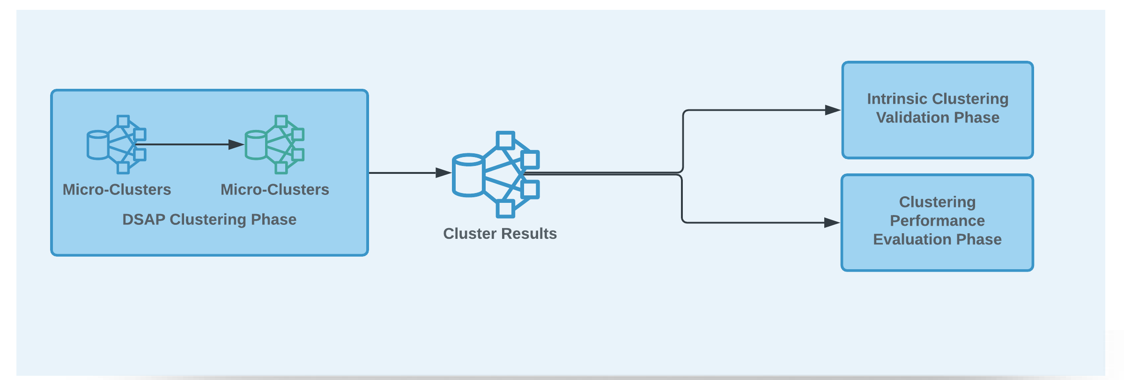
Methodology Data Stream Affinity Propagation (DSAP)
DSAP Clustering Phase
Computes micro-clusters using a landmark time window model to harvest data streams. It also computes macro-clusters by re-clustering all the centroids of the micro-clusters found in each time window.
Intrinsic Clustering Validation Phase
Assesses the quality of the clustering results when there is no ground true label of data.
Clustering Performance Evaluation Phase
Estimates the efficiency of the DSAP algorithm using the time and space complexity metrics.
Notes:
the data stream affinity propa algo or dsap is developed
The DSAP algorithm is based on the online micro and offline clustering phases. The online micro-cluster detects arriving data stream and updates the clusters . The offline macro-cluster phase generates summary of clusters from the centroids of the micro-clusters
Then, the quality of clusters and the performance of the algo are assessed in the validation and evalution phases

Slide 12
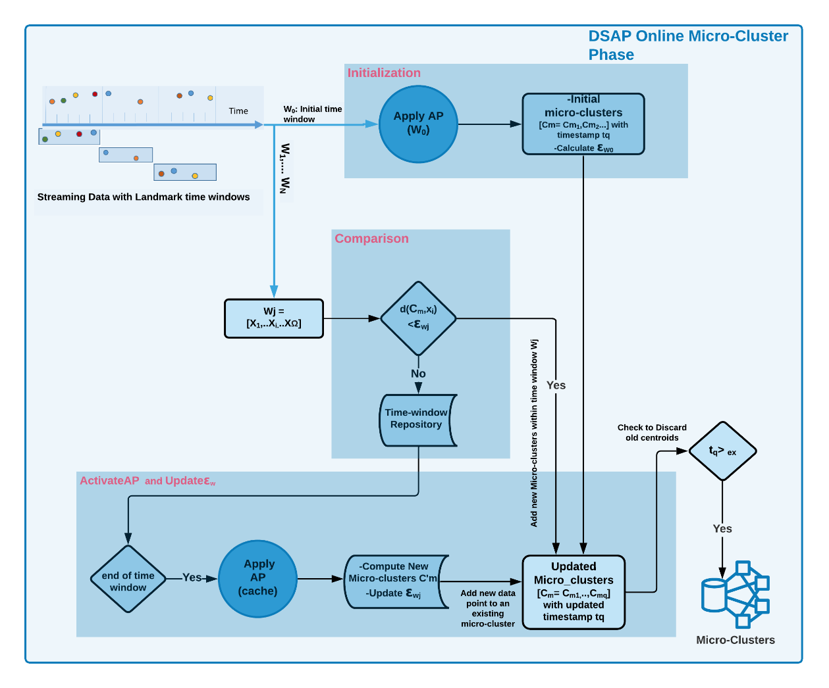
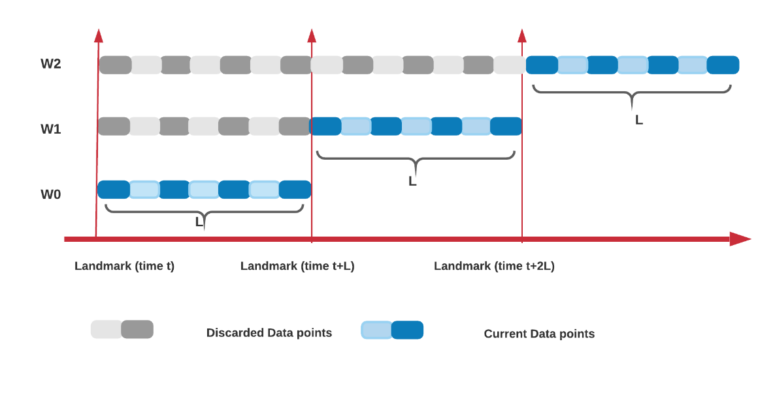
DSAP Clustering Online Micro-Cluster Phase
It initializes by receiving data streams as a continuous sequence of data points that are harvested using the landmark time window model
It consists of three major steps:
Initialization
2. Comparison
3. ActivateAP and Update ɛ_{wj}
Notes:
The online micro clustering phase is initialized upon receiving a sequence of data stream with the landmark time wondow model…
In the landmark time w model All data points in each a window are equally important and they have a same weights,
every time a new window is created, all the data points from the previous window are discarded.
This window model is suitable for our clustering process, because of its simplicity,
and also, we are interested in the most recent data points
This online micro-cluster phase has three main steps
Initialization
Comparison
ActivateAP and Update ɛ_{wj}
____________
the landmark duration can be defined by using a landmark time interval (e.g. every hour) or by a landmark event (e.g. every 100 data points).
The landmark time interval is a-priori determined based on user requirements, data rate, and expected latency of the expected data streams.
. which make appropriate for comparing hourly, daily, or monthly summary comparisons.

Slide 13
Online Micro-Cluster Phase Initialization
Assigning the first sequence of data points to the initial landmark time window W₀ and applying AP algorithm.
Data points are represented as sequence of tuples:
The mean of all the intra-cluster distances gives the initial value of the threshold that will be used in the next step.
s_{q} = (C_{mq}, N_{q}, t_{q})
Notes:
In the initialization step, the data points in the first window are clustered by using ap algo.
And initial micro-cluster centroids are generated in this step
And they are represented as tuples: with
the centroid of a cluster, the number of data points assigned to the cluster,
the last timestamp assigned to it.
The mean of all the intra-cluster distances gives the initial value of the threshold.
The intra-cluster distance is the Euclidian distance between each data points and the centroids
_______________________________________________
The AP algorithm is applied to the all data points of first time window for computing the initial micro-clusters and their centroids.
Cmq is the centroid of a micro-cluster q,
Nq is the number of data points assigned to the cluster q,
tq is the last timestamp assigned to the micro-cluster q.

Slide 14
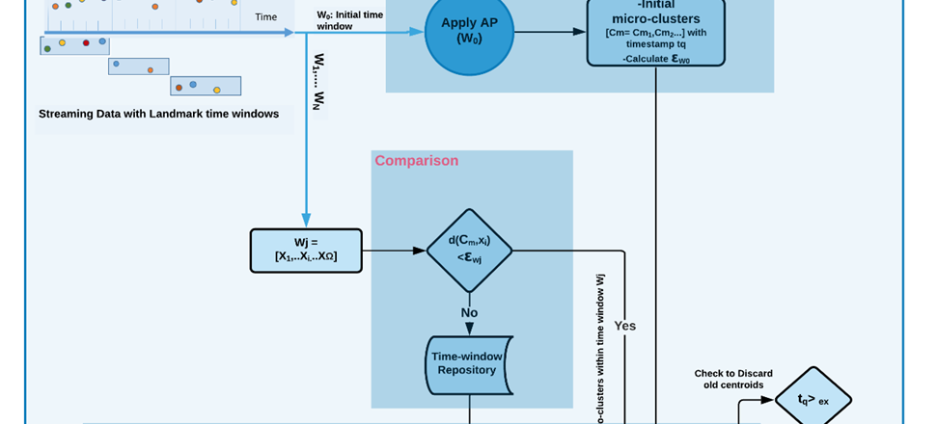
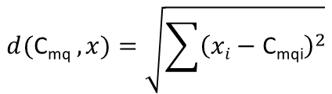
Online Micro-Cluster Phase Comparison
Compute the Euclidean distances between each new data point(x_{i}) and the current micro-cluster centroids (C_{mq})
Compare the computed Euclidean distances against the current ɛ_{wj}
$$d(\text{C}\text{mq} ,x)=\sqrt{\sum{{\left(xi−\text{C}\text{mq}\text{i}\right)}^{2}}}$$
min (d([C_{m}], x_{i})) < ɛ_{wj}
YES → Add to existing clusters
NO → Time-window repository
Notes:
In The next comparison step we want to figure out if new data point belongs to an existing cluster or not
To do this
we calculate the Euclidean distances between each new data point and the current micro-cluster centroids.
If the Euclidean distance of any data points to its closest centroid is less than the threshold,
it is absorbed by that cluster
else it is put in the time window repo
________________________
min (d([C_{m}], x_{i})) → min mean → closest centroid to each data points
.

Slide 15
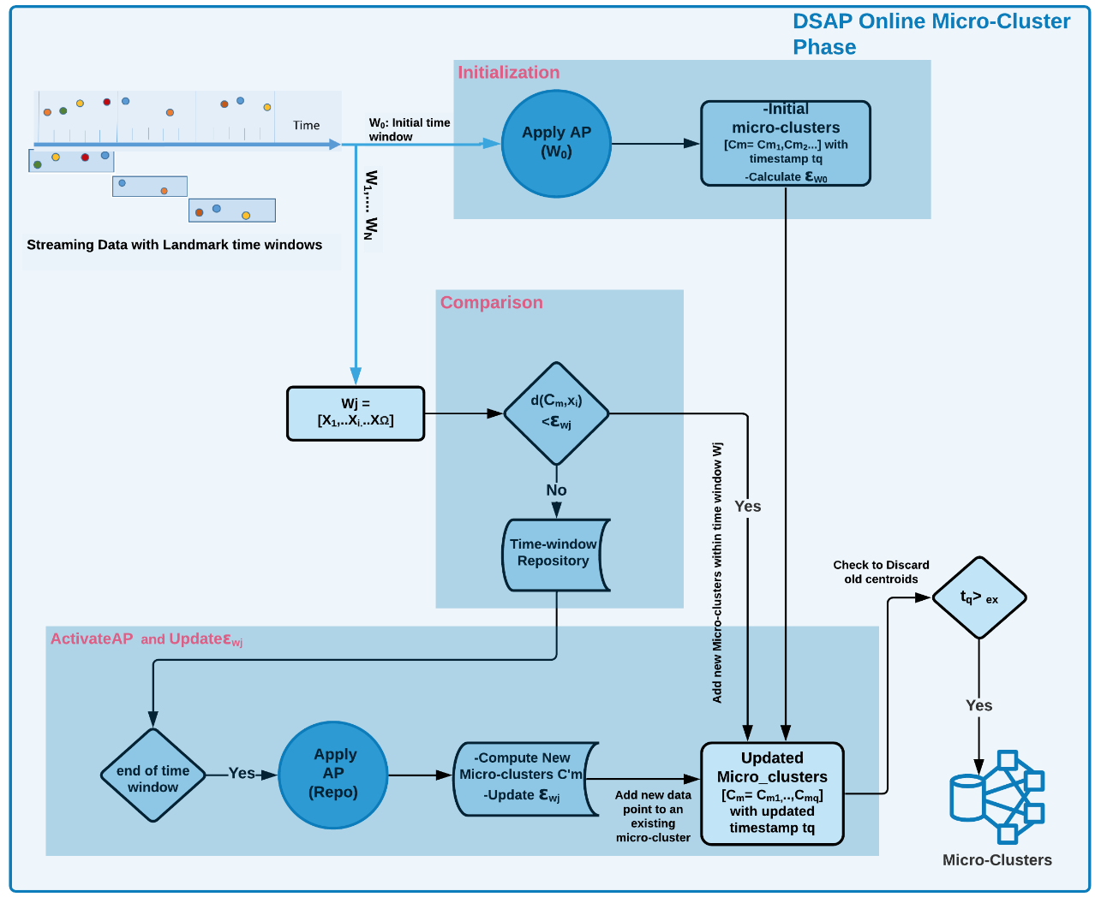
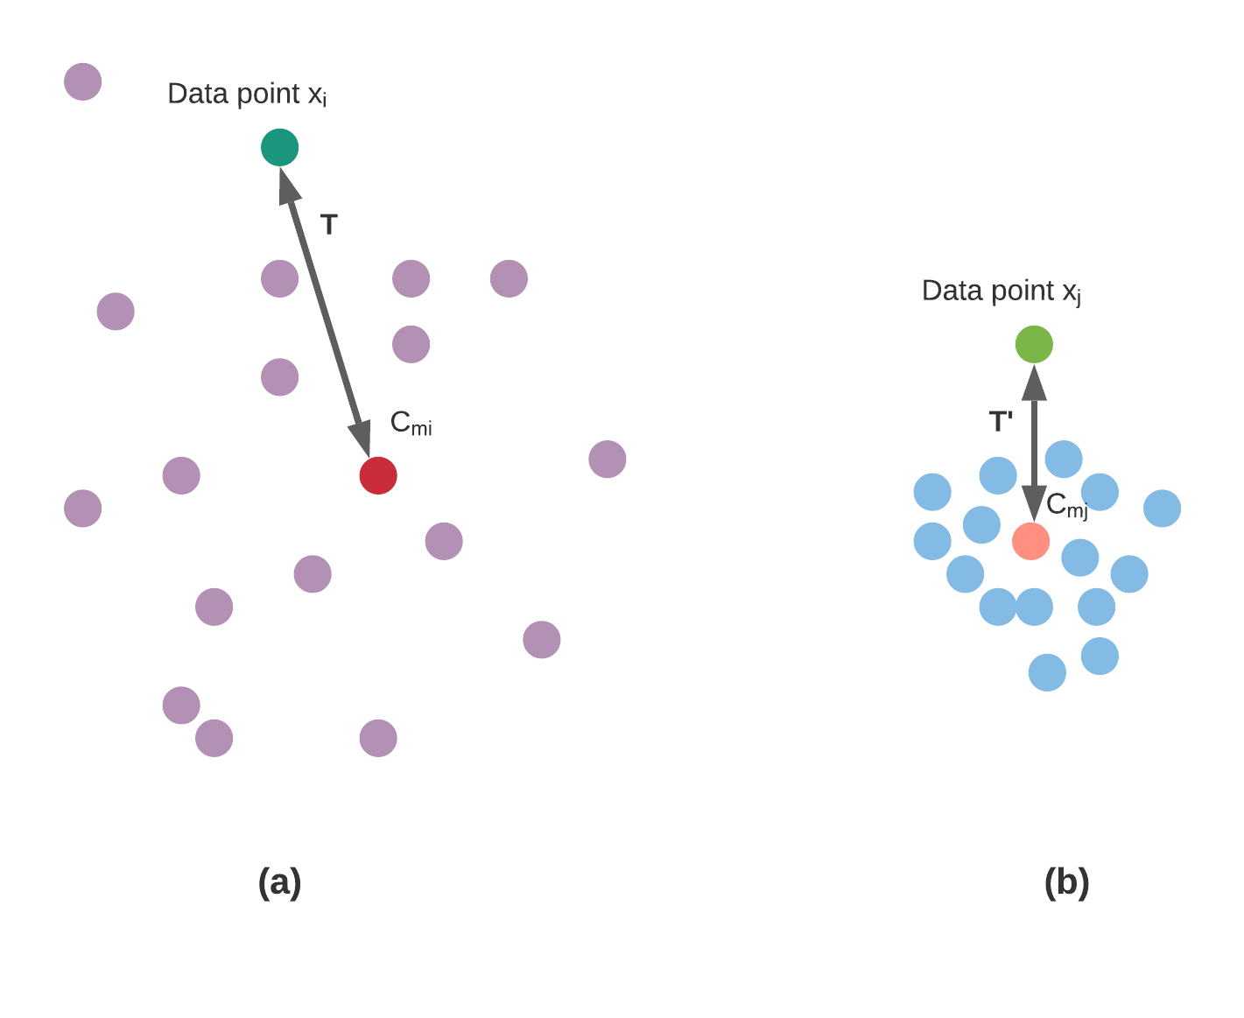
Online Micro-Cluster Phase ActivateAP and Update ɛ_{wj}
ActivateAP
All the data points that have been temporarily accumulated using a time-window based repository will be used to compute new micro-clusters using the AP algorithm once again.
Dynamic Threshold
The update ɛ_{wj} is computed by applying the mean between the new and the current ɛ_{wj}.
Expiration time
In order to avoid the number of centroids spreading beyond control, old centroids that are no longer deemed relevant are removed.
Notes:
In The last step of the online phase, new micro clusters are generated and the threshold is updated
We apply AP algo on All the data points that are temporarily(briefly) accumulated in time window repo
to compute new micro-clusters
These new clusters are added to the existing clusters
Because of new clusters, we need to update threshold.
To do this, First we compute the mean intra-cluster distances of the new clusters, and then
The updated threshold is computed by taking the average of the new and the current threshod
To avoid the number of centroids grow beyond control, old centroids that are no longer active should be removed. This is done by keeping only the clusters with timestamp more than the expiration time.
The expiration time also enable the algo to access older data
In end, The online phase gives us a set of micro-clusters which representation the current state of the data stream
________________________________________
The new micro-clusters will have their timestamps associated with them.
Figure showing a sparse and a dense micro-cluster with their respective centroids Cmi and Cmj . With the arival of
new data points, xi and xj , the intra-cluster distances T and T0 are computed in a
time window W1. In this case, the T distance is less than the current W1 , and the
new data point is merged with the existing cluster Cmi (Figure 4.3a). In contrast,
the computed distance T0 is greater than the current the current W1 threshold, and
this new data point will be saved in the time-window repository until the end of the
streaming for the time window W1 (Figure 4.3b). These tasks are performed every
time a new landmark time window is created and new data points arrive.
.

Slide 16
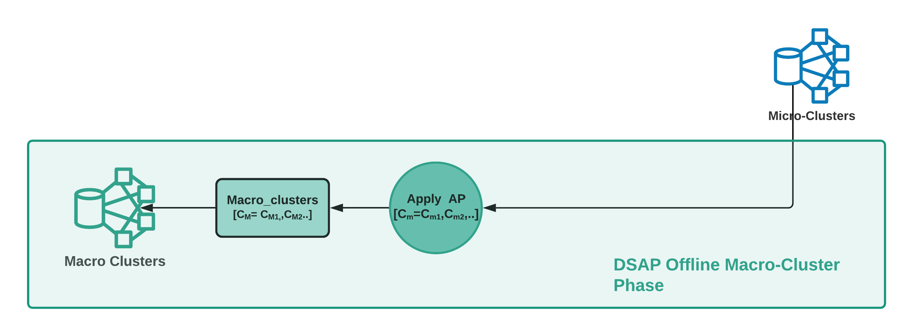
DSAP Clustering
Offline Macro-Cluster Phase
All the micro-clusters generated during the online micro-cluster phase are re-clustered using the AP algorithm to generate k number of macro-clusters
Notes:
The offline phase gives us final clusters from the aggregated summary data .
In this phase, all the micro-clusters generated during the online phase are re-clustered by appling the AP to generate macro-clusters And it starts after N time windows have passed
_____________________________________
In online phase it is ineffiecient to analyze larger windows and the access to older data is dependent on the expiration time.
The offline macro-cluster phase in DSAP. In this phase, all the micro-clusters generated during the online phase are re-clustered by appling the AP to generate macro-clusters.
the number of macro-clusters is expected to be less than the numberof micro-clusters.
Online approach though does not allow for investigation of the cluster structure at different time intervals
generate more accurate ultimate clustering results according to the summary data
give clustering results of any time

Slide 17
Intrinsic Clustering Validation Phase
Metrics | Description | Advantage | Disadvantage
Silhouette Index | It measures how similar a data point is to its own cluster compared to other clusters. | Value bounded between [-1,1] High scores when clusters are well separated | High computational complexity Higher value for convex clusters
Calinski-Harabasz Index | It is the ratio between the intra-cluster dispersion and the inter-cluster dispersion. | Fast to compute Easy to interpret | Higher value for convex clusters
Davies-Bouldin Index | It is the average similarity measure of each cluster with its most similar cluster. | Simple to implement | Limited to Euclidean distance only Higher value for convex clusters
Notes:
Intrinsic clustering validation uses the internal information of the clustering process to evaluate the goodness of a clustering structure when data doesn't have any label.
These metrics are :
Silhouette index which is defined for each data point , to measure how similar a data point is to its own cluster compared to other clusters.
This score is bounded between -1 for incorrect clustering and +1 for highly dense clustering.
Calinski-Harabasz score relates to a model with better defined clusters or well-separated clusters. The index is the ratio of the sum of between-clusters dispersion and of inter-cluster dispersion for all clusters.
The last index or Davies-Bouldin Index which measures the average similarity of each cluster with its most similar cluster.
All These 3 indexes have a drawback which they are higher for convex clusters, such as density based clusters like DBSCAN clusters.
>

Slide 18
Clustering Performance Evaluation Phase
Time Complexity
The amount of time taken by an algorithm to run, as a function of the length of the input.
Space Complexity
The memory consumption quantifies the amount of memory taken by an algorithm to run as a function of the length of the input.
Notes:
AP computational complexity is N²log(N).
Then the performance of the DSAP algo is evaluted by time take of algorithm to run and The memory consumption

Slide 19






Implementation
Python 3.7. Spyder 3.3.6 IDE
ML library
data manipulation and analysis library
Plotting library
Data stream simulation framework
arrays and matrices library
The code is freely available: https://github.com/nasrineshraghi/DSAP
Notes:
The DSAP Implemented in python programming language and
we used different libraries such as skitit multiflow which is used to mimic the data stream and convert the collected data into a stream maner
The DSAP code is freely available in the link below , and I love to collaborate
_____________________________________________
Scikit-multiflow is a free and open-source tool and it is part of the River machine learning library in Python
The DSAP uses the skmultiflow.data.FileStream class for generating data stream
Functions: next sample(), has more samples()
form batch-to-stream conversions or generate standard data streams like waveform
_

Slide 20
Experiments
Notes:
dsap was used to analyze data from 2 different indoor localization experiment

Slide 21



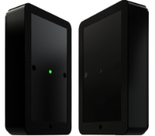
Behavioural Intervention Experiment
The data were collected from February 21, 2019, until July 16, 2019
Pre-processing task applied
Removing data
Zero values
String to integer conversation
Feature Space
Position
Count
Landmark time window of one hour
Six-story building populated by students and staff with entrances facing north and south directions
Tonsley building at the campus of Flinders University, Australia.
This study was conducted to observe the potential impact of motivational and educational interventions on the physical activity of people with sedentary lifestyles.
3 month of experiment (Before, during, and after intervention)
E-counter sensors: wireless infrared people counters digitally record the number of people who goes through the beam (PRx20W1 – PTx20-1)
Notes:
The goal of first experiment was to increase physical activity at work to reduce the health risks related to increasing sedentary lifestyles.
This Experiment was conducted across the 6 levels of the tansley building over a period of 3 month To observed any behavioral changes in staircase usage
the First month was used as a control month to understand normal building use.
During The second month, motivational and educational intervention was done ,to encourage stair use.
The motivation included screen in the building near the lifts, provide health information and live feedback .
For The last month, digital monitoring was continued to understand if any long term behavioral change happened after intervention.
This study used people counters sensors placed on stair cases. When someone passes, it counts.
Finally, We used 2 feature in time for cluster analysis: Position and count
Also landmark time window of 1 hour have been chosen
___________________________________________
Signals from the sensors are sent to wireless hubs in real time and then from the hubs to the server.
This ecounter dataset is a large collection of mobility stair usage database in this building. This dataset contains a total of 668000 records for levels , including people count, direction of movement, date and time .
DSAP will be use for data analysis of ecounter
The most relevant measurements for this cluster analysis were the location of people counter sensors at the Tonsley building and the number of people passing through these sensors. The landmark time window of one hour was used to accumulate the data streams
The streaming cluster analysis was aimed at finding any evolutionary patterns in stair usage based on an educational intervention campaign

Slide 22
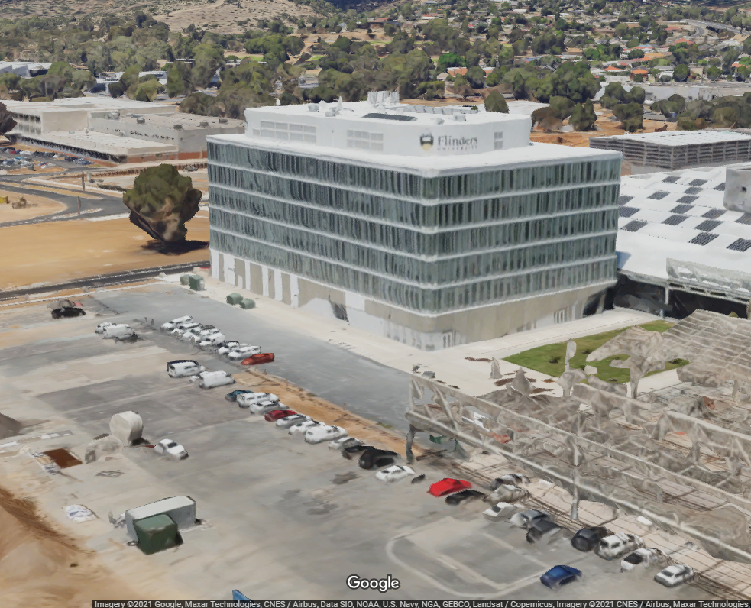
E-counters Location in the Tonsley Building
The sensors are placed at six locations: Level 2-1, Level 3-2 Center, Level 4-3 North and South, Level 5-4 North and South
Level 4 North and South Stairs
Notes:
These 2 figures show the tonesly building inside and outside
The image on the left is the building overview of the north side
And the image on the right is the building plan for level 4 which stairs used for the experiment are highlighted with the red dashed circles
as you can see here in this map mostly all the rooms and classes are located in the south side

Slide 23


Occupant Behaviour Experiment
The data were collected from May 30 to June 20, 2013
Pre-processing task applied
Change Datetime format
Making unique space identifier
Feature Space
PHONEID
SPACEID
Landmark time window of 10 minutes
Universitat Jaume I campus, in Valencia, Spain
This case study was carried out to find occupant behavior patterns in indoor spaces to provide relevant information for future planning building
During 1 month (6 discrete days)
Three buildings with four or more floors
110.000 m² of space
Users carried mobile devices
18 user with 16 phones
Android Device
Notes:
The second experiment created at the university of Joma first in 2013 , is a reference database for Wlan fingerprint-based indoor localization to compare different indoor localization methodologies.
We used this experiment to find a occupancy behavior in indoor spaces. The measurement was done across 3 buildings
For this experiment, 18 participants with 16 cell phones measured their position as they moved around the buildings .
I should mention that We used 2 feature in time for cluster analysis: phone and position identifier
Also landmark time window of 10 min have been chosen for this analysis
___________________________________________
In a WiFi positioning system, tags are WiFi transmitters that send simple packets to a number of WiFi access points in a facility. These access points report the time and strength of that reading to a backend, which uses algorithms to compute position. The location information is then sent to the cloud.
Using Wi-Fi hotspots and other wireless access points to discover where a device is located.The most common and widespread localization technique used for positioning with wireless access points is based on measuring the intensity of the received signal (received signal strength indication or RSSI) and the method of "fingerprinting".
RSSI localization techniques are based on measuring signal strength from a client device to several different access points
Traditional fingerprinting is also RSSI-based, but it simply relies on the recording of the signal strength from several access points in range and storing this information in a database along with the known coordinates of the client device in an offline phase. T During the online tracking phase, the current RSSI vector at an unknown location is compared to those stored in the fingerprint and the closest match is returned as the estimated user location. Its main disadvantage is that any changes of the environment such as adding or removing furniture or buildings may change the "fingerprint" that corresponds to each location, requiring an update to the fingerprint database. However, the integration with other sensor such as camera can be used in order to deal with changing environment
Wi-Fi location uses already existing infrastructure and Wi-Fi access points (APs) to calculate where a device is located. The device needs to be able to listen for the Wi-Fi AP but does not need to connect to it. By analyzing the signal strength of multiple Wi-Fi signals and knowing the location of those APs, Skyhook is able to determine the approximate location of the device.
Each Wi-Fi access point, whether customer hotspot, router or Internet-capable point of sale system, transmits specific data. Using a RSSI (Received Signal Strength Indication) and MAC address (Media Access Control), an app can calculate the current location of the end user device (client-based positioning). This requires a database with information about the locations with which this data can be compared. This method is called fingerprinting. It only functions with Android devices due to technical restrictions. iOS devices cannot be used for Wi-Fi indoor navigation.

Slide 24
Results
Notes:
In the result section I will discuss the data from each experiment and the clustering results

Slide 25
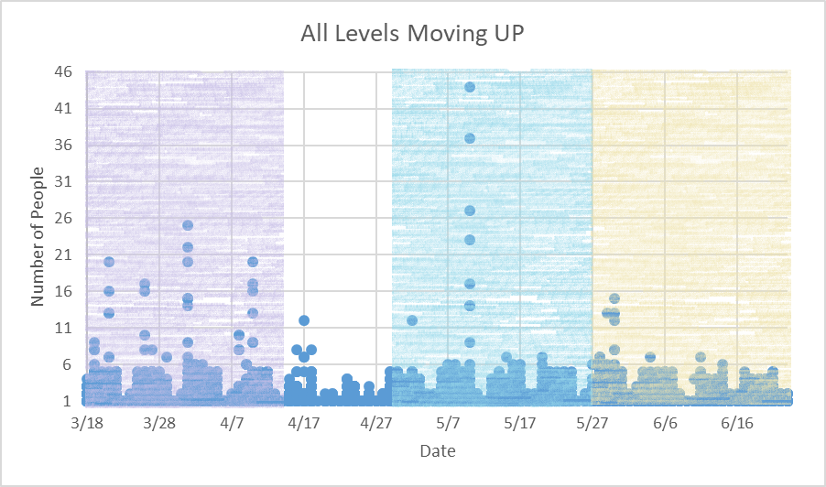
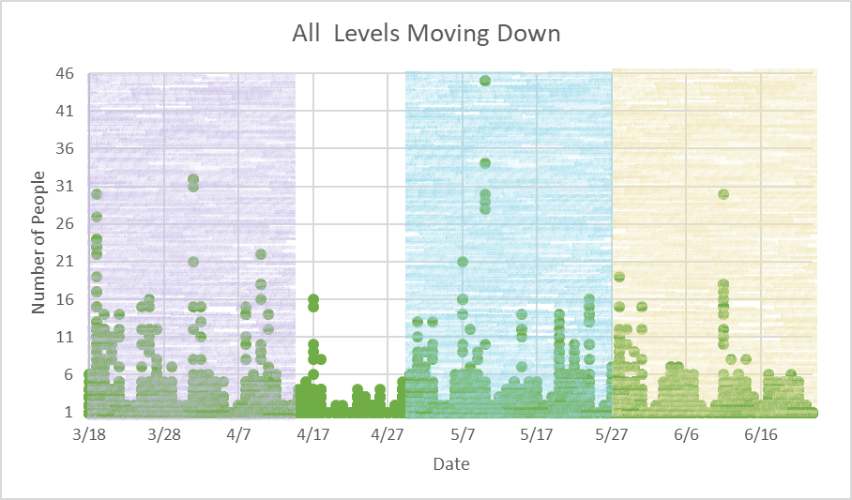
Behavioural Intervention Experiment Spatio-temporal Data Patterns
<15%
Pre-intervention → March 18-April 14, 2019
During-intervention → April 29- May 26, 2019
After-intervention → May 27- June 23, 2019
Notes:
These figures show the stair usage pattern of people moving up and down .
The first month or pre intervention month is shown with purple color
The intervention month is shown with blue color
The white gap between pre-intervention and intervention month was the 2 weeks of semester break which we excluded from the study.
The post intervention moth immediately starts after the intervention month as shown in yellow color.
As expected15% more people used the stairs to go down than go up.
.

Slide 26
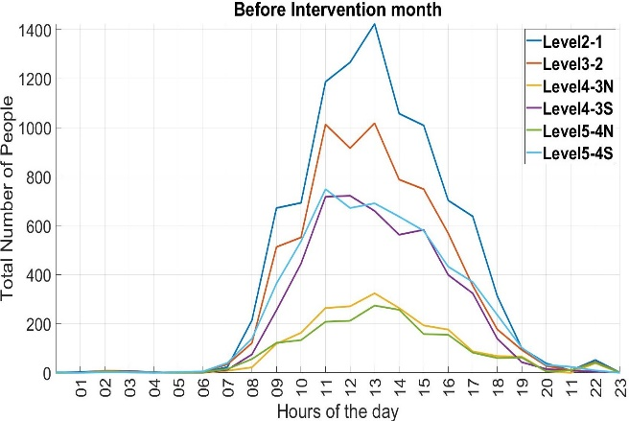
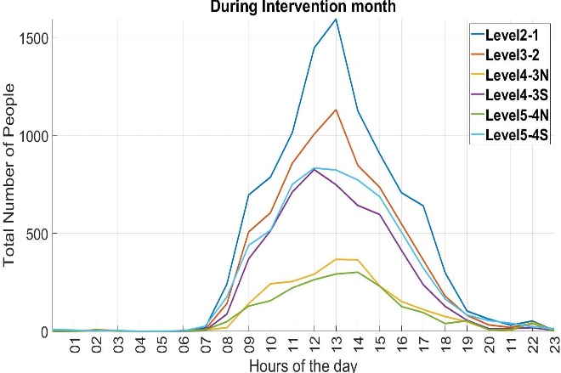
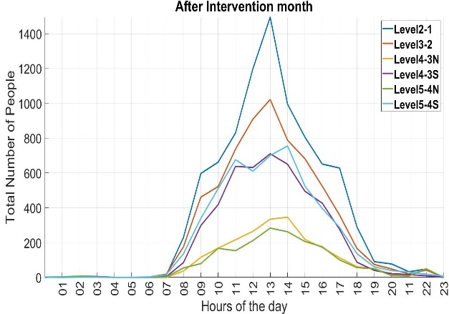
Notes:
These 3 plots shows the spatio-temporal patterns of each level for each month. These are generated by aggregating the number of people at each level
It is clear that the Level 2-1 stair, was most used; and the North side stairs were used the least.
This could be because of fewer people using the north entrances since the it leads to a low capacity parking lot
also the peak usage was around noon for all 3 months. people have used the stairs in the afternoon rather than in the morning.
___________________________ - There is a lot more activity in the evening as compare to early morning
.

Slide 27
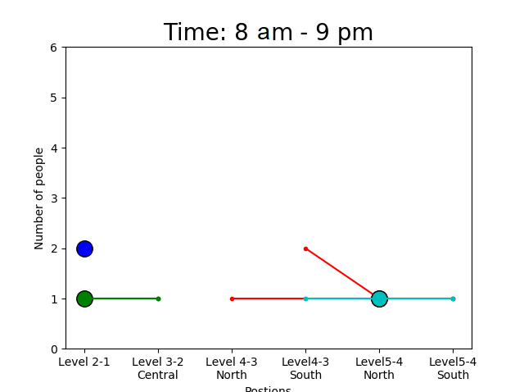
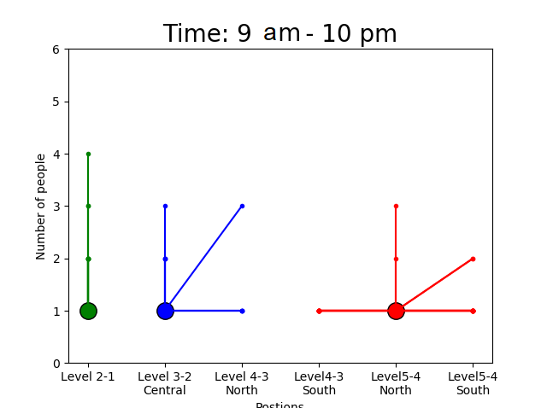
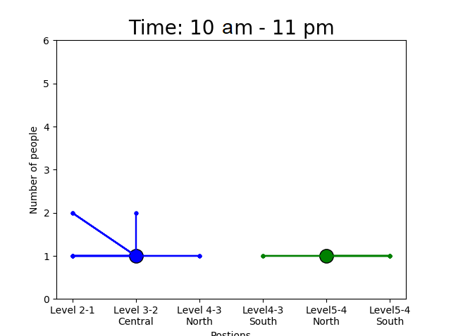
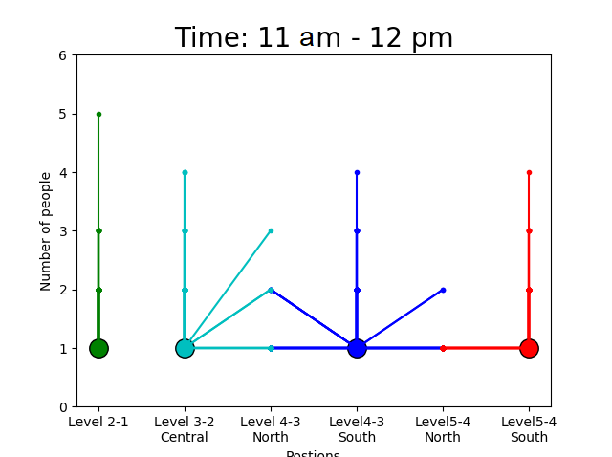
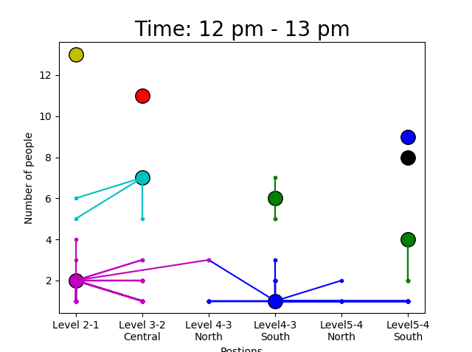
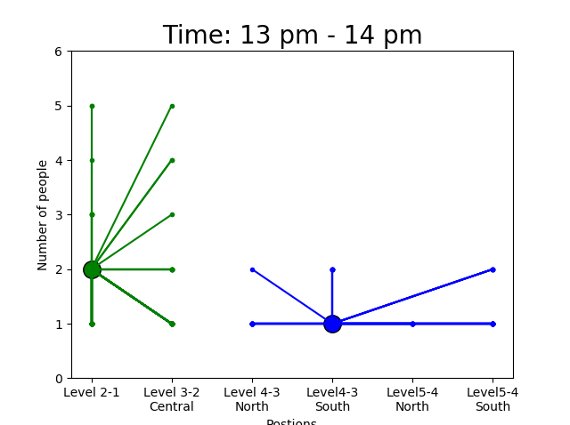
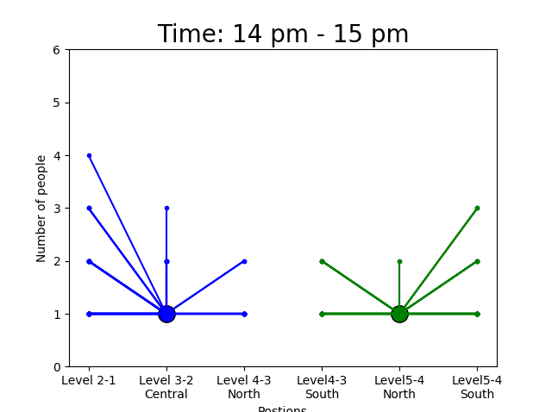
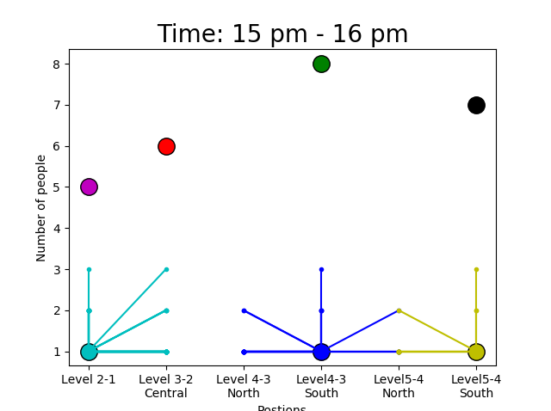
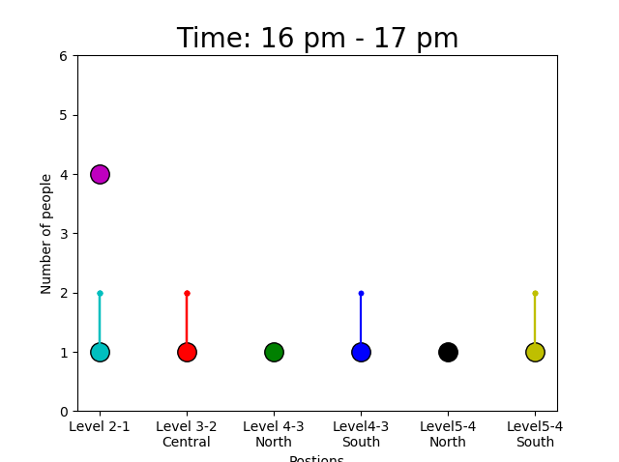
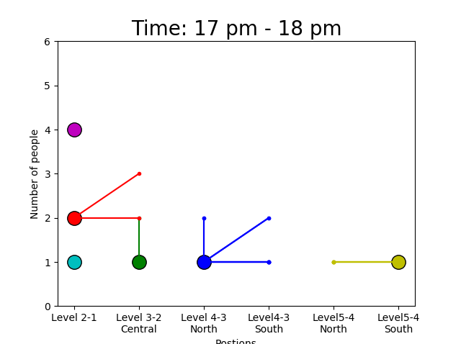
Behavioural Intervention Experiment Micro-cluster Evolution
Notes:
The dsap algo is capable of analyzing the evolution of micro-clusters. The clusters of every hour for one day are shown in these plots.
These Figures show the centroids of the micro-clusters and their data points that are connected, using straight lines.
The one-hour expiration time was chosen to ensure that only the data points in the one-hour window were used
The changes in stair usage across all levels can be clearly seen.
**The micro-clusters show an increase in activity starting around 9.
**At the peak around noon, the micro-clusters become more dense, and happening at different levels of the building.
As the day pas, the number of micro-clusters gradually decreases.
These generated patterns show the potential of using the DSAP for finding meaningful micro-clusters over space and time.
And the ability to continuously find micro-clusters with any changes in the stream data.
_______
.

Slide 28
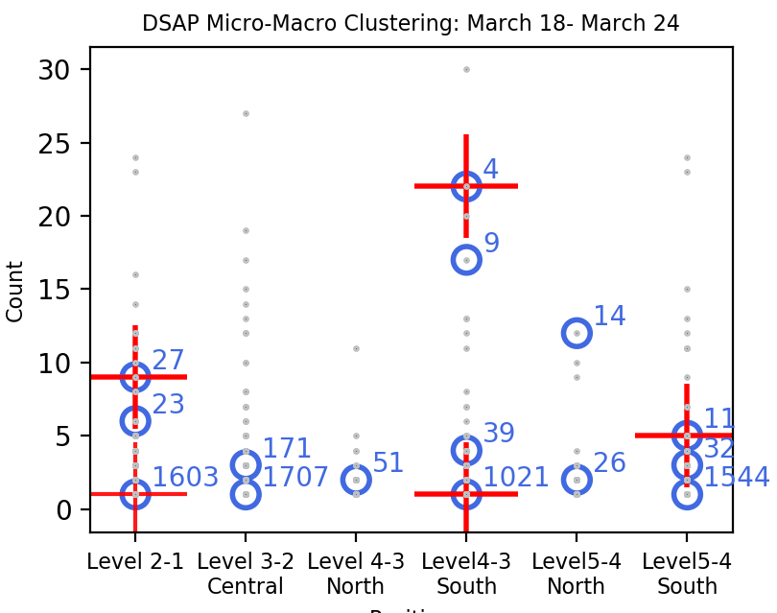
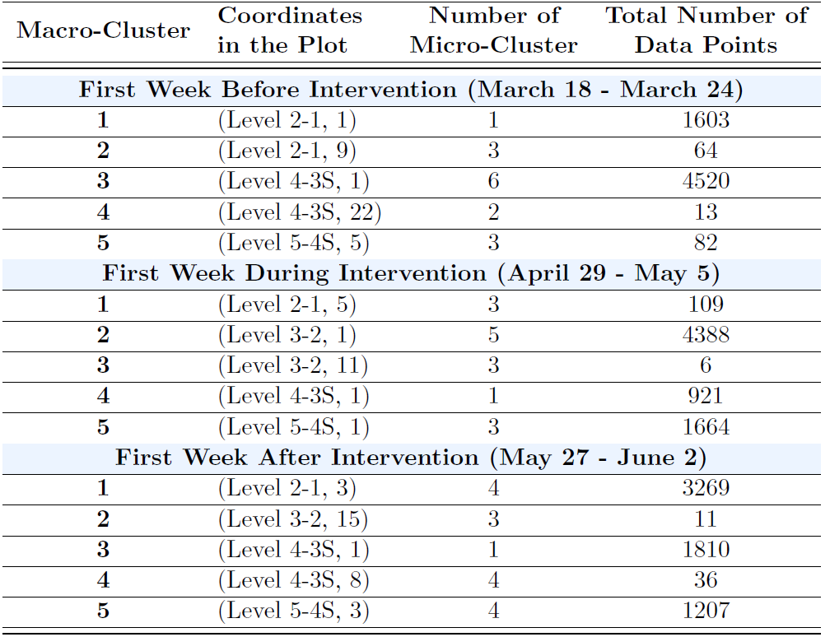
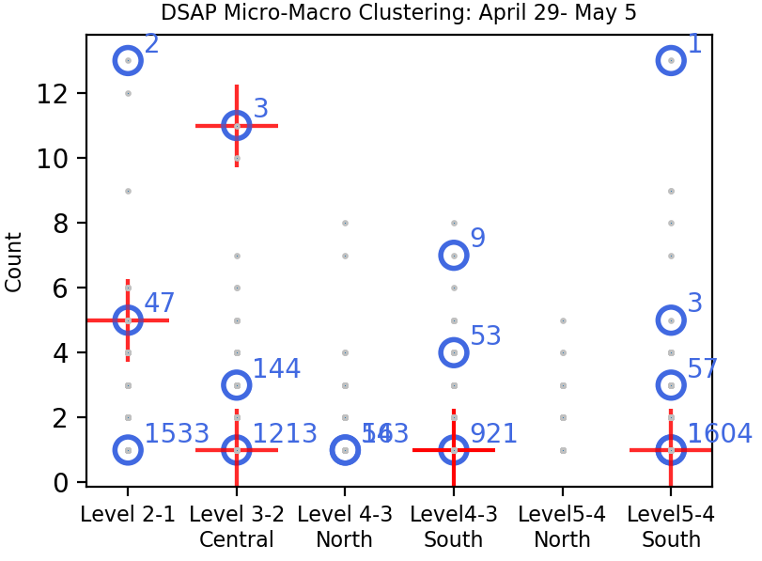
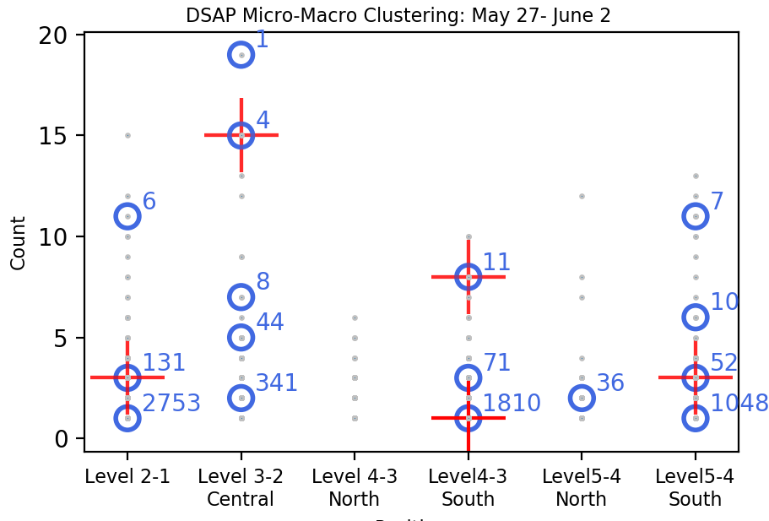
Behavioural Intervention Experiment Micro and Macro-clusters: Weekly Patterns
Before Intervention
During Intervention
After Intervention
+ Macro cluster
O Micro cluster
. Data point
Notes:
The first week of each of the three months was selected to find weekly pattern and then compare results with standard Affinity Pro algo.
The micro and macro clusters from DSAP are shown here, and the summary of all these clusters are presented in the table. The expiration time equal to 168 hours was used
The micro cluster centroids are shown with blue circles , centroids of the macro-clusters by red crosses and grey dots are data points.
The numbers of data points associated with each micro-cluster are mentioned next to it.
Five macro-clusters were found for each week, having a variety of density values ranging. The trend of high-density clusters with low counts is presented in data.
***the macro-cluster (level4-3S,1) was selected during each of the three weeks of the analysis, but with different number of micro-clusters and data points.
During the first week of intervention a weak impact was seen in stairs between level 4-3 north.
______________________________________________________________________________
Finally, the intervention campaign has not increased the usage of stairs between level 2-1. No
campaign has also shown to have a anomalous clusters were found in these results.
.
______________________________

Slide 29
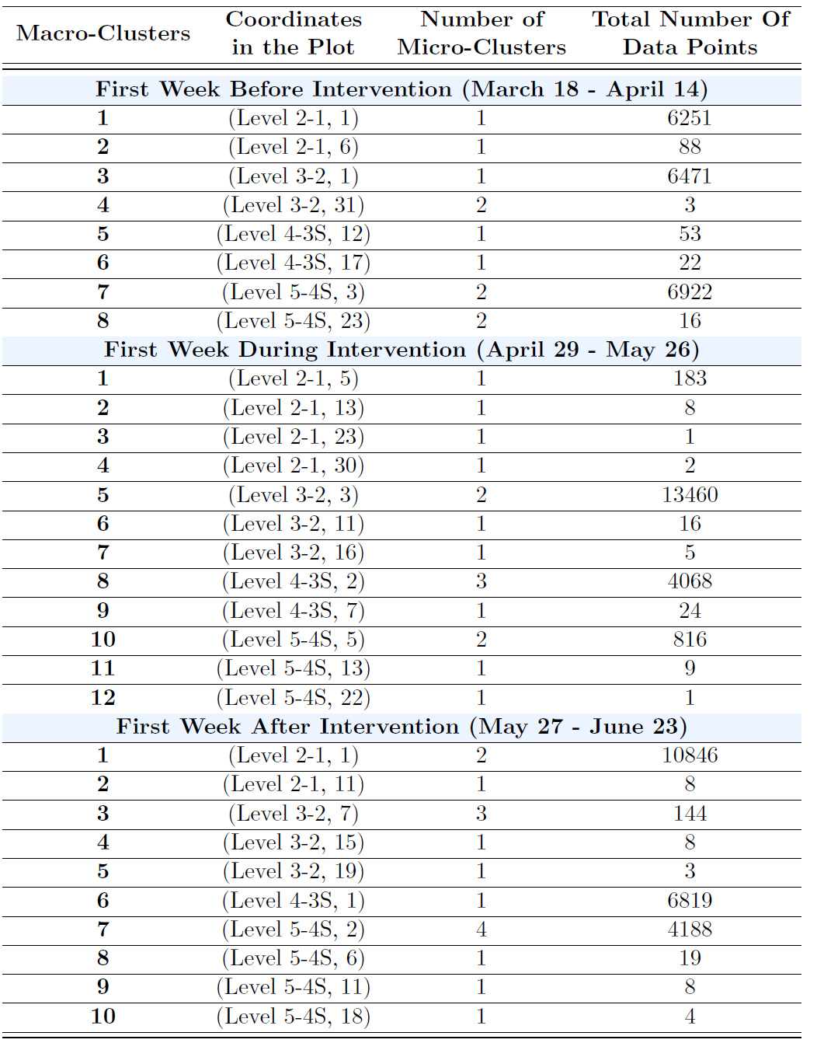
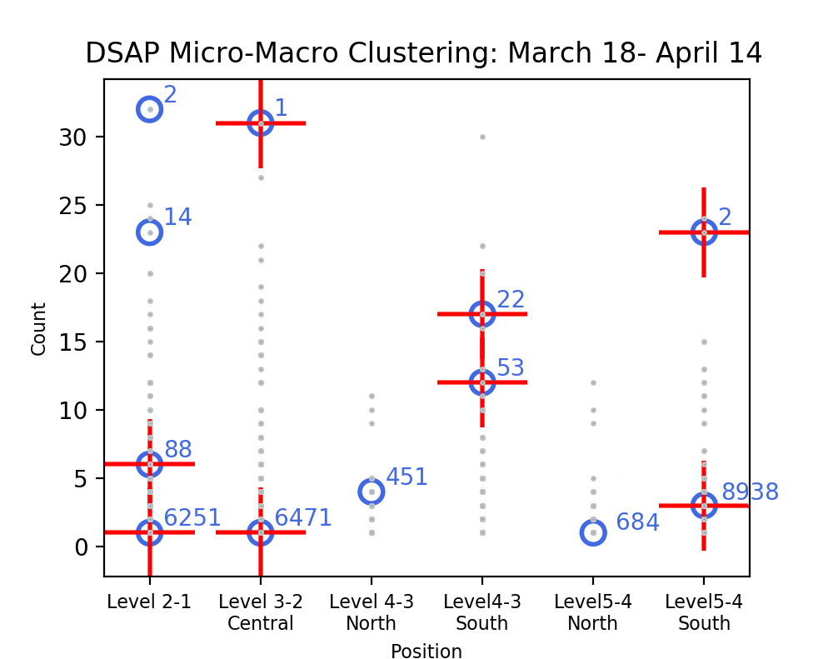
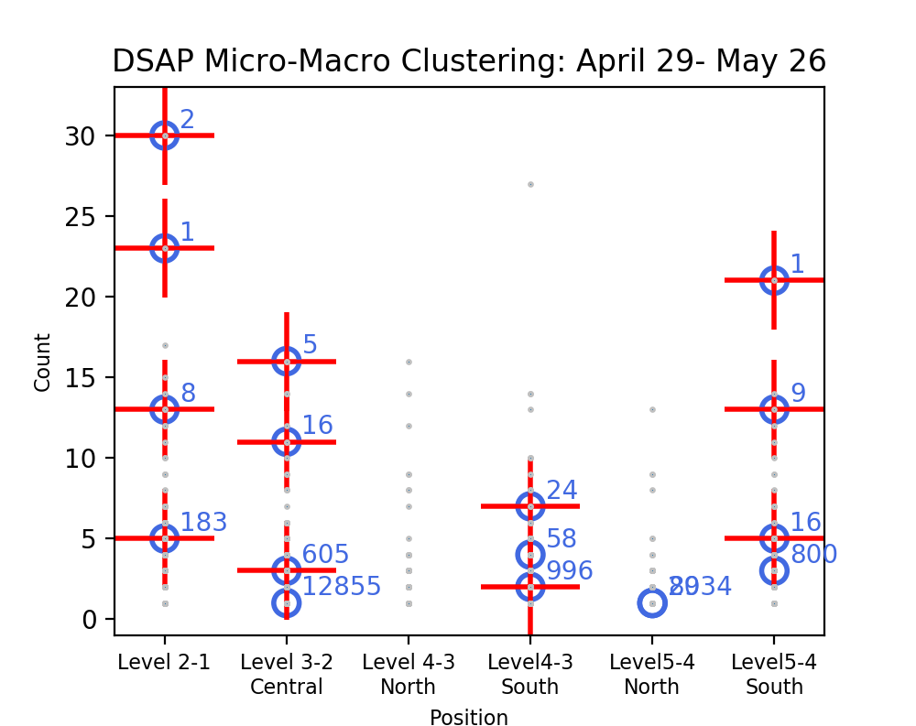
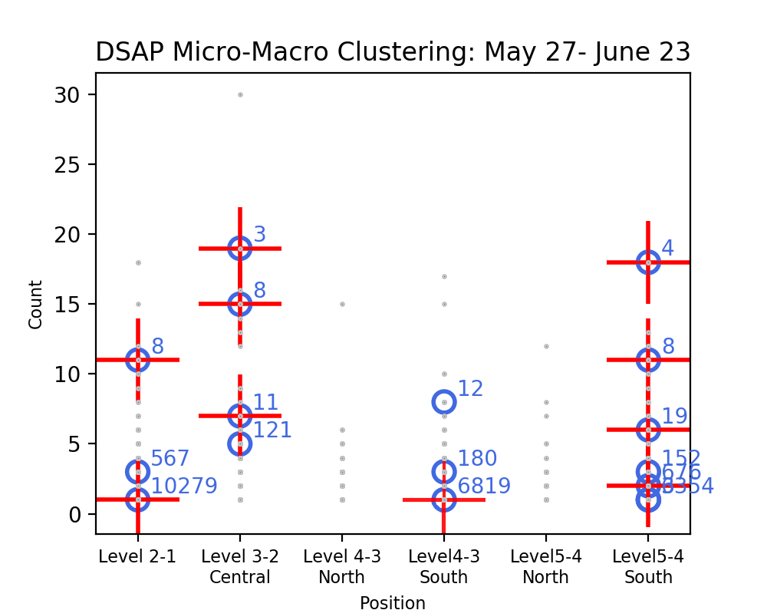
Micro and Macro-clusters: Monthly Patterns
Before Intervention
During Intervention
After Intervention
+ Macro cluster
O Micro cluster
. Data point
Notes:
the final clustering results for the 3 month are shown in these plots
The expiration time value is kept to total hours of month
***all macro-clusters for these three months are at levels 2-1, 3-2, 4-3 south and 5-4 south, confirming that these levels saw the highest frequency of people.
**Also, two dense clusters with the number of data points equal to 53 and 22 were observed at Level 4-3 South ,before intervention. These clusters most probably correspond to a group of people using stairs during this month. This behavior is not seen in the other two months.
**It is clear during intervention month gave the most number of macro-clusters.
**also, the pattern is slightly different. The densest cluster at Level 3-2 represents 13460 data points during intervention which the other 2 month have densest cluster at level 5-4 South for before and Level 2-1 for after intervention.
Level 5-4 south is the only stair that keeps its behavioural pattern similar for the entire three months.
The people counter experiment was performed in order to find any improvement in stair usage after some measures for educational interference was made.
There are no obvious signs for an overall increase in stair usage during and after the month of intervention.
____________________________
,

Slide 30
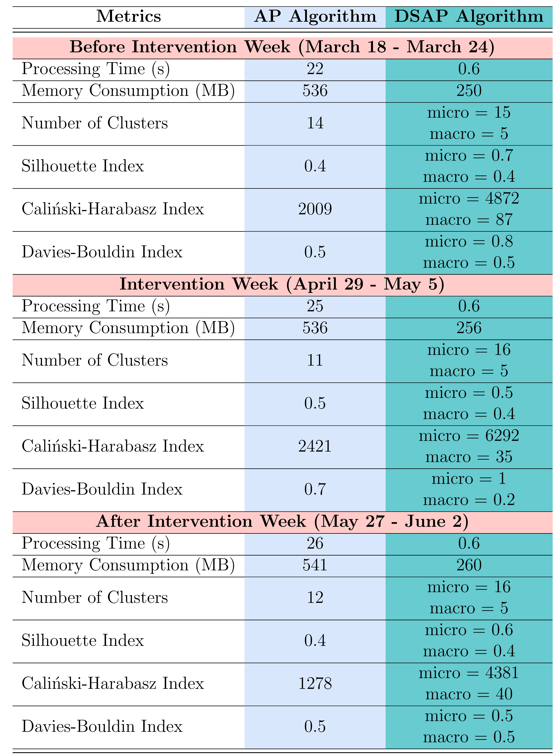
Behavioural Intervention Experiment Performance and Validation Metrics
For the DSAP evaluation, the AP model was used as a baseline
A significant saving in processing time and memory is immediately apparent between the DSAP algorithm and AP
Notes:
to compare the performance and validation metrics, the AP model was used as a baseline.The micro-clusters generated by DSAP show slightly improved values,
**Reduction in processing time and memory consumption is immediately apparent between the DSAP algorithm and AP. The initial window calculation is the most time-intensive step but is performed only once and does not affect the current time window.
The number of AP clusters and micro clusters are similar and it shows DSAP generates consistent clusters .
The 3 indices that are used to evaluate the clusters show that micro cluster generated by DSAP have better result than AP clusters
_______________________________________
It should be noted that the number of points represented by a cluster signicantly affects some of these metrics, and hence internal evaluation metric numbers need to
be carefully interpreted.

Slide 31
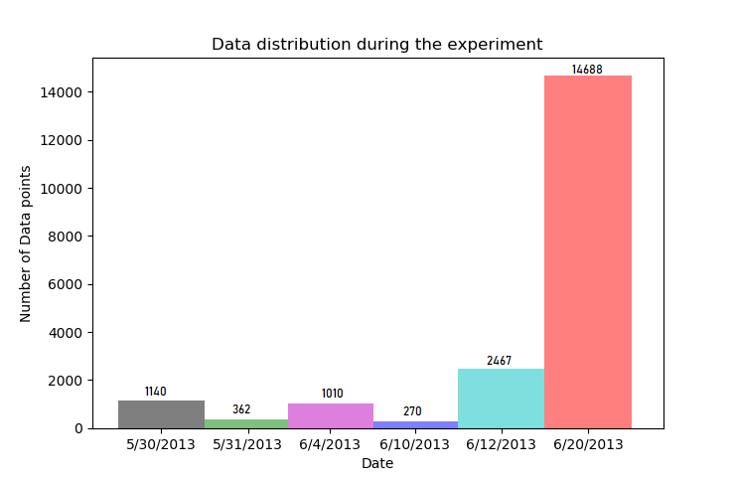
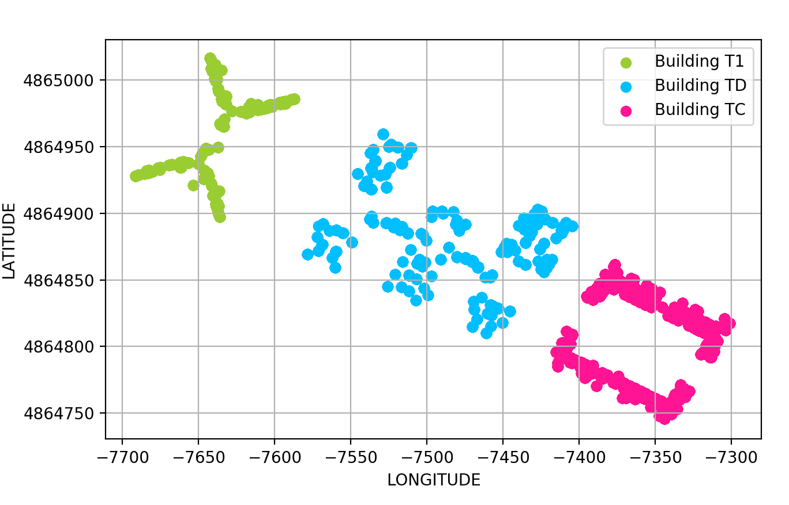
Occupant Behaviour Experiment Spatio-temporal Data Patterns
Notes:
streaming cluster analysis for the second experiment was carried out to find occupancy patterns in different buildings at the university campus,
The experiment lasted for six days from May 30 to June 20, but June 20 was selected for the cluster analysis since signicantly more data points were collected on this day
**Figure on the right shows an overview of the spatial distribution of all data points according to the indoor spaces of the three buildings named as T1, TD, and TC,
The first five days of data was available from building T1, but on June 20, data streams were available for both buildings TD andTC.
The distribution of the data closely follow the shape of the buildings.

Slide 32
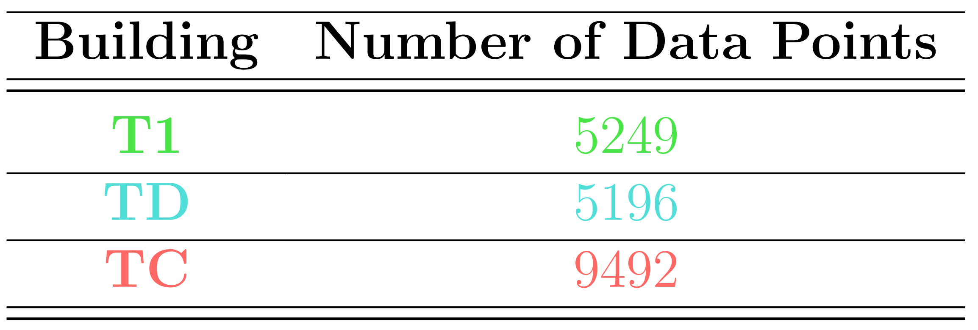
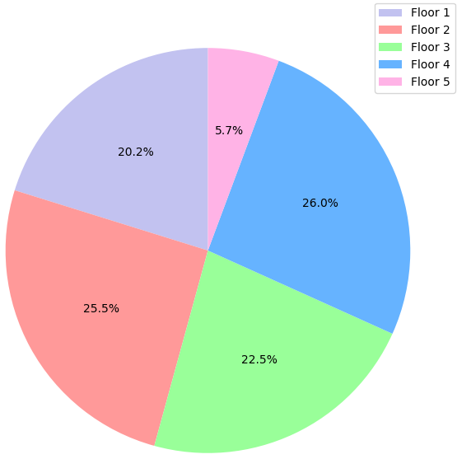
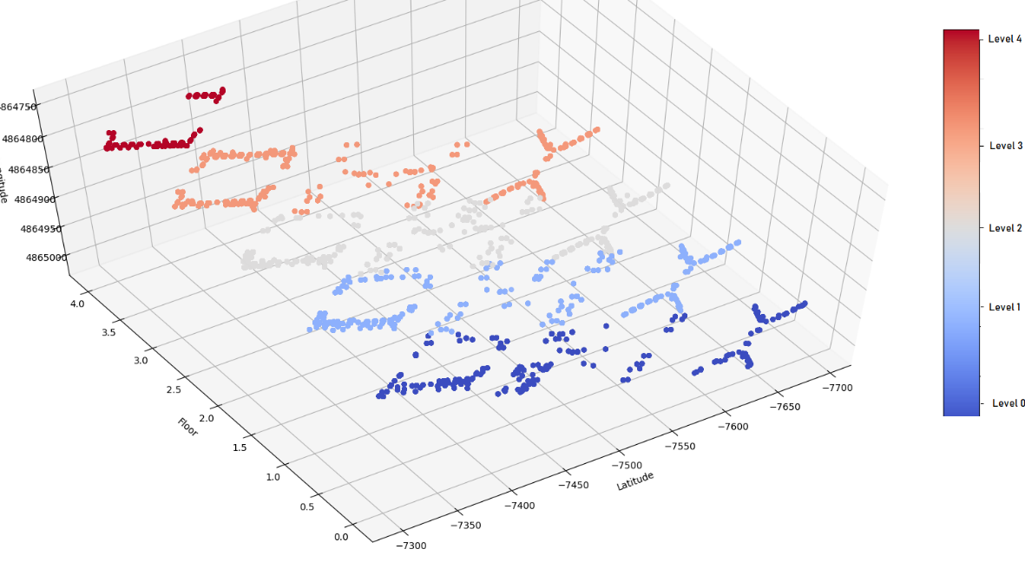
Notes:
This figure shows the spatial distribution over the floors .building TC is the only one with 5 floor
**the total number of data points generated for each building is provided in this table. the building TC has contributed to 47% of the whole data.
**data points gathered at different floors of all buildings are shown in this pie chart . the total number of data points gathered at different floors of all buildings was similar except for the fifth floor which belongs to only one building

Slide 33
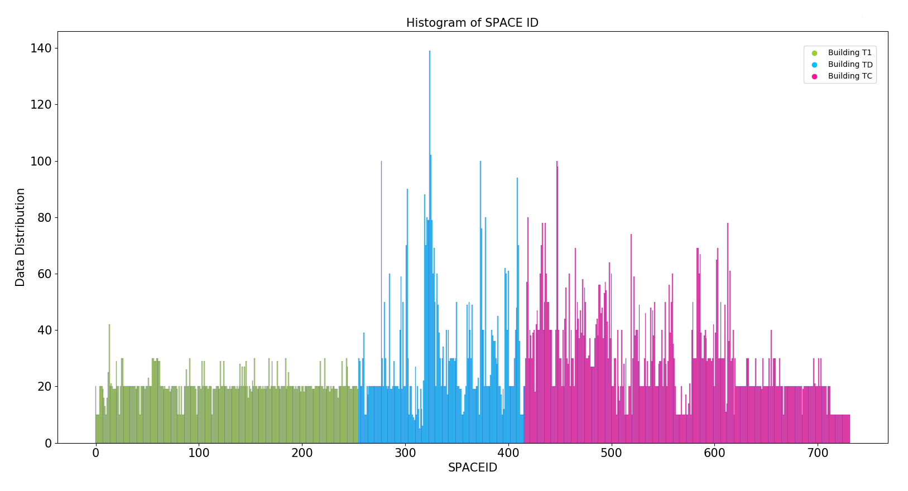
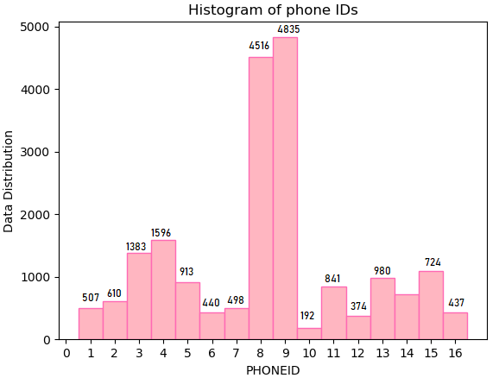
Occupant Behaviour Experiment Spatio-temporal Data Patterns
0 to 255
256 to 416
417-732
Notes:
For the stream cluster analysis, the space and phone identier are used. Space id is a unique representative of the indoor spaces like classes, labs, and offices that a participant was occupying during the experiment
Space id has a number ranging from 0 to 732 for 3 buildings.
**SPACEID from 0 to 255 belongs to building T1, numbers between 256 to 416 belong to building TD, and the remaining numbers (417 to 732) belong to building TC.
**The figure on the right is the histogram of the data collected by 18 phones used by the participants.
The participants with the phone number 8 and 9 generated most of the data during the experiment.

Slide 34
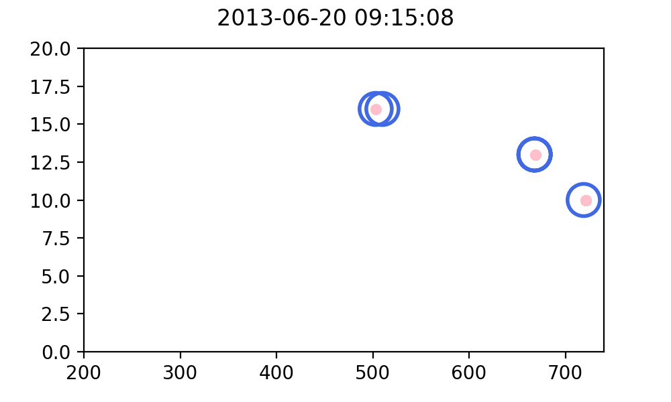
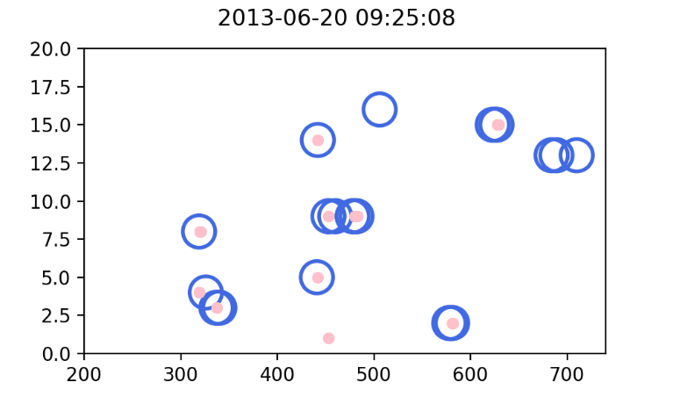
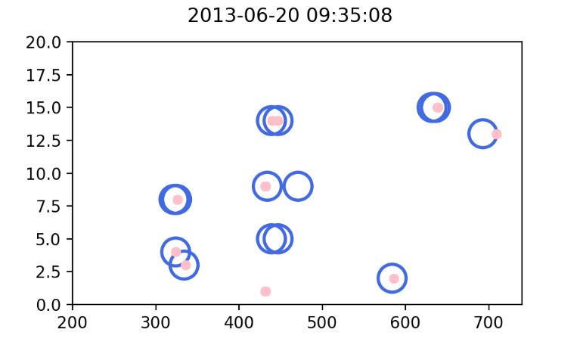
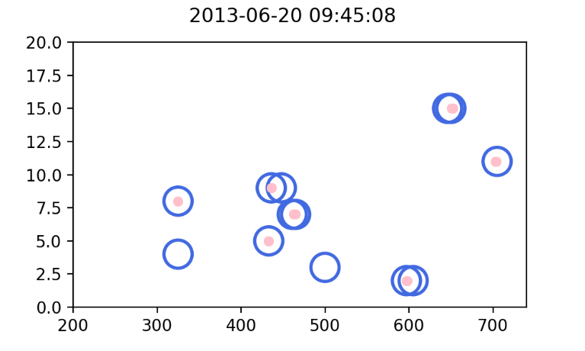
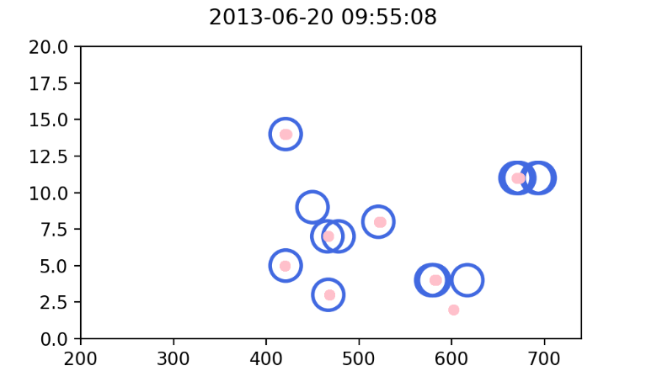
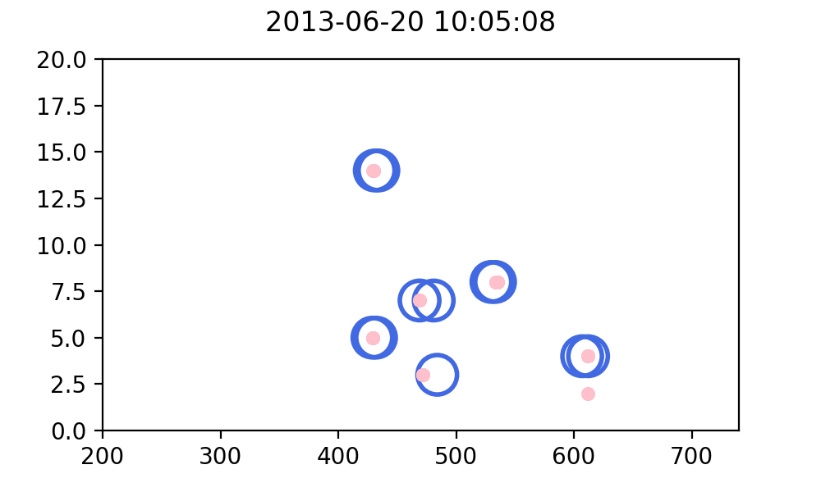
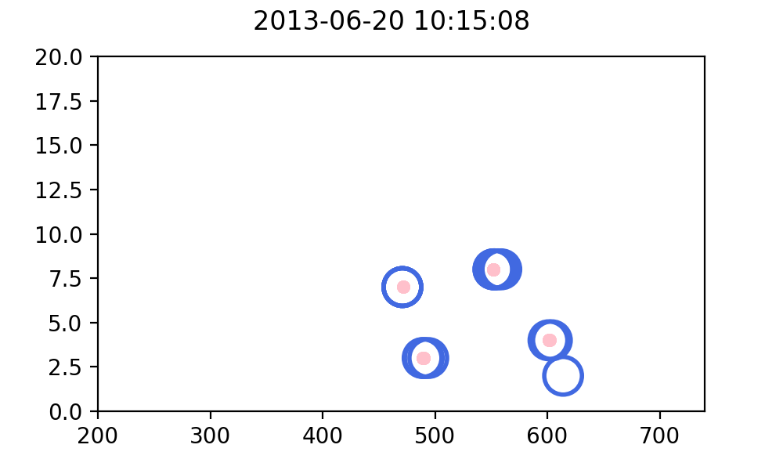

Occupant Behaviour Experiment Micro-cluster Evolution
O Micro cluster
Data point
T1: 0 to 255 ,
TD: 256 to 416 ,
TC: 417-732
Notes:
it is important that the algorithm is able to find representative micro-clusters that reflect the changes in the occupants behaviour.
This evolutionary process can be seen in these Figure between 9:15 to 10:25 am on June 20.
a 10-minute time window and an expiration time of one window was used to generate these plots.
The patterns show that two or more users rarely occupy the same indoor space. They also show how the micro-clusters provide an overview of the movement in the buildings.
so, these plots show the strength of the DSAP to detect and track people's occupancy over a short period of time, in this example which is 80 minutes.

Slide 35


Occupant Behaviour Experiment Micro and Macro-clusters
+ Macro cluster
O Micro cluster
. Data point
O Macro cluster
O Micro cluster
. Data point
Notes:
The DSAP clustering results for the day June 20 are presented in these Figures.
The first plot is shown micro and macro clusters and The second plot is a summary of this day instread of table that we have for the previous experiment.
**DSAP found dense macro-clusters centered in the indoor spaces 400, 500, and 659, ,
also it also found clusters around SPACEID 300, 470, and 700.
I should mention that x and y axes are not the same scale; so the branches of the clusters might seem like that they are far apart as seen in the right figure , but they, in fact, belong to similar indoor spaces.

Slide 36




Occupant Behaviour Experiment Micro and Macro-clusters
Expiration time value:20,000
Expiration time value:2,000
Clustering results for the entire experiment duration of six days across the three buildings
The DSAP expiration time values of 20,000; 2,000; 1,000 and 200.
Expiration time value:1,000
Expiration time value:200
T1- 0 to 255 ,
TD- 256 to 416 ,
TC- 417-732
Notes:
In rapidly changing data like this, the choice of the expiration time is critical to interpret the data meaningfully.
These 4 plots are clustering results for the entire experiment duration six days across the three buildings with expiration values of 20,000, 2000, 1000, and 200
**The first figure shows clusters for almost the entire data using an expiration value of 20,000 in each of the 3 buildings.
the first five days of data were collected from the first building (T1),
***as we decrease the expiration value from 20,000 to 200, the occupancy behaviour starts reflecting more current data.
Gradually , Building 1 fades out with the lower expiration time values since no measurements were made in the building on the later days.
--
this study Demonstrates the capability of DSAP to analyze occupancy behavour data stream across multiple buildings . it can be expanded on a larger scale with 1000 of users

Slide 37

Occupant Behaviour Experiment Performance and Validation Metrics
The AP model was applied as a baseline to compare the performance and validation metrics.
The DSAP results significantly improve the processing time and memory consumption.
Notes:
Just like what we did, with the ecounter data stream, we used The AP model as a baseline to compare the performance and validation metrics for occupancy behavour experiment .
June 20 was selected for this evaluation.
*** Results follow similar trends showing significant decrease in memory consumption and processing time.
The 3 indices that are used to evaluate the clusters show that micro cluster generated by DSAP have satisfactory values.

Slide 38
Summary
A new data stream AP clustering (DSAP) algorithm is proposed for uncovering evolutionary patterns using the landmark time window model.
The DSAP algorithm consumes less memory and takes significantly less processing time as compared with AP. The quality of clusters generated by DSAP were consistently better.
The impact of a motivational intervention on the physical activity of people was analyzed. The impact of intervention was not apparent though a slight increase in stair usage was observed.
The second experiment was used to find out the occupancy behaviour in three buildings. The DSAP results show the ability of this algorithm to capture rapid changes in occupancy behaviour.
Notes:
To sum up, A new data stream AP clustering algorithm is proposed to find evolutionary patterns
The DSAP algorithm is more efiicient n terms of memory consumption and processing time as compared with AP. The quality of clusters generated by DSAP were consistently better.
For the first experiment, motivational intervention on the physical activity of people was analyzed. The impact of intervention was not clear although a slight increase in stair usage was observed.
The second experiment was used to find out the occupancy behaviour in three buildings. The DSAP results show the ability of this algorithm to capture rapid changes in occupancy behaviour.

Slide 39
Conclusions
The main advantage of the DSAP model relies on its simple and straightforward approach but still retaining the strengths of other streaming AP-based algorithms while removing some of the complexities introduced by them.
Benefits
Simple and fast landmark time window
Low processing time
High cluster accuracy
Potential to be applied to other indoor localization systems
Limitations
DSAP was not tested using live data streams
Not tested for latency and bandwidth problems
Notes:
This algorithm has some advanages most importantly,
Less processing time
Using a landmark time window model
Quality of clusters
It is aplicapable to other indoor localization systems
And it has some limitation like
DSAP hasn’t tested using live data streams
Not tested for latency and bandwidth problems
The strength of the DSAP algorithm in finding meaningful patterns and providing new insights from indoor localization data is demonstrated.

Slide 40
Future Research Work
Adding new parameter to the DSAP algorithm, for example, another distance function depending on the data distribution and shape of the clusters
Different time window models
The performance of the DSAP model needs to be tested using live data streams
Explore the effects of scalability and noise on the performance and robustness of the DSAP algorithm
Benchmark test would be interesting to evaluate the DSAP model against the existing streaming AP models using standardized data sets
Notes:
The future work will be such as:
Using Multiple distance functions depending on the data distribution and shape of the clusters
Different time window models are applicable
The performance of the DSAP model should be tested by live data streams
Explore the effects of noise on the performance of the DSAP
And finally Benchmark test , to evaluate the DSAP model with the existing streaming AP models using standardized data sets

Slide 41
Thank you!
“Live as if you were to die tomorrow. Learn as if you were to live forever.” ― Mahatma Gandhi
Notes:
tank you all for listening and
and specifically , I would like to thank Dr. wakovich for her guidance and support for the last 2 years.

Slide 42
Backup slides

Slide 43
Cluster Analysis
Distances
Distance functions are predominantly used to determine a proximity measure of dissimilarity/similarity between clusters. This proximity measure directly affects the formation of the resulting clusters.
Notes:
In the Euclidean based on other norms distance. And usually for 2 data points
Manhattan distance is a rectilinear distance, named after the number of blocks (in the north, south, east or west directions) a taxicab must travel on, in order to reach its destination on the grid of streets in parts of New York City.
The Minkowski distance can be considered as a generalization of Euclidean distance and the Manhattan distance.
Cosine distance is often used for text data)
Mahalanobis distance( detect outliers,) : It is a multi-dimensional generalization of the idea of measuring how many standard deviations away P is from the mean of D.

Slide 44
indoor positioning techniques
WLAN
Wireless Bluetooth techniques
Infrared ray (IR) techniques
Radio frequency identification (RFID) techniques
Ultrasound techniques
Ultra-wideband (UWB) Techniques
Ultrasonic system
Cellular based techniques
Notes:
Wlan : has become very popular in public hotspots and enterprise locations during the last few years.
Bluetooth: technology is mainly used in small-scale positioning, such as single-room or warehouse
Rfid : range is very limited
Ultra-wideband (UWB) : can be used for precise indoor positioning like robot motion tracking
Ultrasonic :triangulation positioning algorithm to determine the location of objects.—needs a lot of the underlying Hardware infrastructure investment, the cost is too high.
Cellular-Based:mobile cellular network(GSM) to estimate the location of outdoor mobile clients
IR System:
The principle of infrared positioning is that infrared IR modulated infrared ray emission is identified by the optical sensor installed in the indoor positioning receiver. Although the infrared has a simple structure, low cost and relatively high accuracy indoor etc., because light cannot pass through obstacles, it makes the only line of sight infrared ray communication. The two main disadvantages of the indoor positioning are Short sight lines and Transmission distance

Slide 45

Stream Clustering Methods and Algorithms

Slide 46




Time window models
Damped Time Window: It is also referred to as time-fading model. Each data point has a different weight based on its arrival time so new data points have a higher weight than the old ones.
Landmark Time Window: It is also known as the hopping model, and is used when clustering starts from a starting point call landmark to the current time. When a new window comes, all data points from the previous landmark time window are removed. All data points are equally important.
Sliding Time Window: The most important data points are the most recent ones and old data points will be removed.
Pyramidal Time Window: It is also known as tilted time window and focuses on recent data points without discarding old data points.
Notes:
To capture the spatio temp data stream and analyze them , time window technique needs to be applied. The goal of time wondow mo is to ‘forget’ historic data which might bias the analysis to outdated patterns.. 4 types of time window models exist.
sliding time is based on a FIFO principle, where the oldest data point in the window is removed when a new data point becomes available. there is a fixed size of the window. As time passes, the window with the size w slides from the current time.
The damped time window assigns a weight to each cluster which is based on the number of observations
.
landmark time window separates the SPT data stream into chunks of data based on events. When a new landmark happens, all the data in the window is removed and new data is captured
peramidal : focuses on recent data points without discarding old data points . It applies various time granularity levels based on how recent a data point is . Also The old data points are aggregated

Slide 47

Notes:
Unbounded streams have a start but no defined end. They do not terminate and provide data as it is generated. Unbounded streams must be continuously processed, i.e., events must be promptly handled after they have been ingested. It is not possible to wait for all input data to arrive because the input is unbounded and will not be complete at any point in time. Processing unbounded data often requires that events are ingested in a specific order, such as the order in which events occurred, to be able to reason about result completeness.
Bounded streams have a defined start and end. Bounded streams can be processed by ingesting all data before performing any computations. Ordered ingestion is not required to process bounded streams because a bounded data set can always be sorted. Processing of bounded streams is also known as batch processing.

Slide 48



Batch processing vs. stream processing
Under the batch processing model, a set of data is collected over time, then fed into an analytics system. In other words, you collect a batch of information, then send it in for processing.
Under the streaming model, data is fed into analytics tools piece-by-piece. The processing is usually done in real time.

Slide 49

Divide and Conquer

Slide 50


Slide 51
LR

Slide 52


Affinity Propagation 2006
Partitioning message passing algorithm
Determine the optimal number of clusters for the user
Algorithm stops when convergence is achieved.
AP matrices
Similarity Matrix: Similarity between any data points
Responsibility Matrix: How well-suited point k is to be an exemplar for point i
Availability Matrix: Contains values that correspond to how available one object is to be an exemplar for another object
Criterion Matrix: Sum of the availability matrix and responsibility matrix, the highest criterion value is designated as the exemplar
Notes:
Affinity propagation (AP) is a partitioning-based clustering algorithm .
It considers all data points as a potential centroids until an optimal set of clusters and their centroids are found during iteratration.
AP calculate 4 matrices
similarity matrix shows how well the data point is to be the centroids . And it is obtained by calculating the negative Euclidian distance squared.
The Responsibility matrix contains values that represent how likely is a data point to be a cluster center.
for example in this fig data point k1, sends message to candidate exemplar i and gets the response back to figure out if point i is good point to be cluster center for k1.
The Availability matrix reflects how appropriate it would be for point i to choose point k as its exemplar.
Those two matrices actually represent a graph where every data point is connected with all other points. For five data points we could imagine a graph like here.
________________________________________________________
estimates the similarity between each data point and finds the most suitable cluster center.
In this pic a message from exemplar point kei is sent to point i to find how well it would be for point $i$ to choose point $kei$ as an exemplar
Lastly, in the criterion matrix, each cell is the sum of the availability matrix and responsibility matrix at that location. The highest values of each row are designated as an exemplar.
This message-passing procedure continues until convergence is reached.

Slide 53
Hyper Parameters
Damping Factor: It is the extent to which the current data point is maintained relative to incoming data points.
Preference: For each data point that is more likely to be chosen as an exemplar
Max_iter: Maximum number of iterations.
Notes:
3 main hyper parameters are used
damping factor which should be (between 0.5 and 1), controls the rate of convergence .fast or slow convergence .
preferences. this preference value show how strongly a data point thinks itself should be an exemplar.
For a smaller amount of clusters, this can be set to the minimum value of the similarities.
This value shows the suitability of each data point to be an exemplar.
max_iter defines the maximum number of iterations. Which should be chosen so that the centroids don’t change,

Slide 54



Similarity Matrix (S)
Diagonal Values: Lowest number among all cells→ preference
Non-Diagonal Values: Negative Sum of Squares of Differences
s(Alice, Bob) = -[ (3–4)² + (4–3)² + (3–5)² + (2–1)² + (1–1)² ] = -7
Notes:
Similarity Matrix (c)
every cell in the similarity matrix is calculated by negating the sum of the squares of the differences between participants.
**Foeexample For the similarity between Alice and Bob, the sum of the squares of the differences is 7, then, the similarity value is -7.
**For diagonal, we fill in the diagonal with, the lowest number from among the different cells. Which is -22
-----------------------------------------------------------------
s(k, k) = l . l is referred to as preferences, whose value should be independent and can be set to a constant. Algorithm AP introduces the
fading factor to adjust the iteration speed, and a proper number of fading factor will help to avoid numerical oscillation and improve convergence.

Slide 55


Responsibility Matrix (r)
Where i refers to the row and k the column of the associated matrix.
r(Alice, Bob) = (-7) – (-6) = -1
Notes:
Responsibility Matrix (r)
formula:
which is the similarity between i and k (col) minues max of remaining simuilarity of I (row)
**For example, the responsibility of Bob (column) to Alice (row) is -1, which is the similarity of Bob to Alice (-7) minus the maximum of the remaining similarities of Alice’s row (-6).
After calculating the responsibilities for the rest of participants, we end up with the following matrix.

Slide 56



Diagonal : a(Alice) = 10 + 11 + 0 + 0 = 21
Non-Diagonal: a(Alice, Bob) = (-15 + 0 + 0 + 0 = -15)
Availability Matrix (a)
Diagonal Values:
where i refers to the row and k the column of the associated matrix.
Non-Diagonal Values:
Notes:
For the availablility matrix, formula for diagonal:
sum all the positive values in the column except for its own value( or self responsibility).
non-diagonal value
Self responsibility of data point plus plus the sum of the remaining positive responsibilities excluding
for example alice to bob is Bob’s self-responsibility plus the sum of the remaining positive responsibilities of Bob’s column excluding the responsibility of Bob to Alice

Slide 57


Criterion Matrix (c)
Notes:
The highest value of each row is the centroid.
Rows with same centroids are in the same cluster.
Thus, in our example. Alice, Bob, and Cary form one cluster whereas Doug and Edna constitute the second.
The criterion value of Bob (column) to Alice (row) is the sum of the responsibility and availability of Bob to Alice (-1 + -15 = -16).

Slide 58
APDenStream
AP and density based methods to improve the StrAP model’s accuracy and timeliness in a noisy environment
two-phase clustering approach, the online and offline phases.
The online phase detects data distribution changes due to the new data points, updates the micro-cluster decay density, and generates real-time results. The offline phase, which is invoked by a user who has to choose a specific time frame by applying a pyramidal time window model, gives final query results.
Tested on Intrusion Detection benchmark data (KDD99) and a synthetic Gaussian data
ISTRAP
using a dynamic clustering scheme, which ensures that not only new emerging clusters can be detected, but disappeared and recurrent clusters are also timely detected
Four parameters δ,α,β,λ, are needed to monitor the clustering process
Tested on AS synthetic and the MNIST real-world data
time complexity have increased compared to the StrAP

Slide 59
Methodology

Slide 60




Intrinsic Clustering Validation Phase Silhouette Index
How similar a data point is to its own cluster compared to other clusters.
Value bounded between [-1,1]
High scores when clusters are well separated
High computational complexity
Higher value for convex clusters
Notes:
Silhouette index is defined for each data point , to measure how similar a data point is to its own cluster compared to other clusters.
and is based on two scores:
a: The average distance between a data points and all other points in the same class.
b: The average distance between a data points and all other points in the next nearest cluster.
Advantages
The score is bounded between -1 for incorrect clustering and +1 for highly dense clustering. Scores around zero indicate overlapping clusters.
The score is higher when clusters are dense and well separated, which relates to a standard concept of a cluster.
Drawbacks
The Silhouette Coefficient is generally higher for convex clusters than other concepts of clusters, such as density based clusters like those obtained through DBSCAN.

Slide 61

Intrinsic Clustering Validation Phase Caliński-Harabasz Index
Score dense and well-separated clusters
A higher Calinski-Harabasz score relates to a model with better defined clusters.
The score is higher when clusters are dense and well separated
Fast to compute
Higher value for convex clusters
Notes:
a Calinski-Harabasz score relates to a model with better defined clusters or well-separated clusters.
The index is the ratio of the sum of between-clusters dispersion and of inter-cluster dispersion for all clusters
Formula
and N is the total number of data points
k is the number of clusters,
SSB is between-cluster variance.
SSW is the within-cluster variance
_________________________________________
is estimated based on the distances from the points in a cluster to its centroid. The separation is based on the distance from the centroids tothe global centroid,
For a set of data E of size nE which has been clustered into k clusters, the Calinski-Harabasz score s is defined as the ratio of the between-clusters dispersion mean and the within-cluster dispersion:
The Calinski-Harabasz index is generally higher for convex clusters than other concepts of clusters, such as density based clusters like those obtained through DBSCAN.
------------------------------------------

Slide 62



Intrinsic Clustering Validation Phase Davies-Bouldin Index
Computes the average similarity between each cluster
Simple to implement
Higher values for convex clusters
Limited to Euclidean distance only
Notes:
This index relates to a model with better separation between the clusters.
And it is defined as the average similarity between each cluster and its most similar one
si or sj , are the average distance between each point to the centroid of that cluster – also know as cluster diameter.
D the distance between cluster centroids i and j.
______________________
This index signifies the average ‘similarity’ between clusters, where the similarity is a measure that compares the distance between clusters with the size of the clusters themselves.
Zero is the lowest possible score. Values closer to zero indicate a better partition.
Advantages
The computation of Davies-Bouldin is simpler than that of Silhouette scores.
Drawbacks
The Davies-Boulding index is generally higher for convex clusters than other concepts of clusters, such as density based clusters like those obtained from DBSCAN.
The usage of centroid distance limits the distance metric to Euclidean space.
This index signifies the average ‘similarity’ between clusters, where the similarity is a measure that compares the distance between clusters with the size of the clusters themselves
--------------------------------------------------------
The Davies-Bouldin index (named after its creators, David Davies and Donald Bouldin) quantifies the average separability of each cluster from its nearest counterpart. It does this by calculating the ratio of the within-cluster variance (also called the scatter) to the separation between cluster centroids (see figure 16.4).
If we fix the distance between clusters but make the cases within each cluster more spread out, the Davies-Bouldin index will get larger. Conversely, if we fix the within-cluster variance but move the clusters farther apart from each other, the index will get smaller. In theory, the smaller the value (which is bounded between zero and infinity), the better the separation between clusters. Boiled down into plain English, the Davies-Bouldin index quantifies the mean separability between each cluster and its most similar counterpart.
Figure 16.4. The Davies-Bouldin index calculates the intracluster (within-cluster) variance (left-side plot) and the distance between the centroids of each cluster (right-side plot). For each cluster, its nearest neighboring cluster is identified, and the sum of their intracluster variances is divided by the difference between their centroids. This value is calculated for each cluster, and the Davies-Bouldin index is the mean of these values.

Slide 63
Implementation

Slide 64

Implementation Data Stream Simulation
In order to mimic a data stream, it was necessary to convert the collected data into a stream.
Scikit-multiflow is a free and open-source tool and it is part of the River machine learning library in Python
The DSAP uses the skmultiflow.data.FileStream class for generating data stream
Functions: next sample(), has more samples()
Notes:
The skmultiflow.data module includes two group of classes that either perform batch-to-stream conversions or generate standard data streams like waveform,Gaussian as shown in Figure…The batch-to-stream conversion classes generates streams from a file source (.csv les) in the disk or from data in the memory.
next sample(), which returns the next window at the start of every time interval. Also, the function has more samples() checks if any data point is left in the data set for consideration. Even though these packages are very capable of mimicking the data observed in data stream, the user still must acknowledge the limitations of such techniques.

Slide 65


Slide 68
UJIIndoorLoc Data

Slide 70
System and software
Platform: 64-bit operating system, window 10 Enterprise, 2019. The specifications of this machine are: Intel Core i7 2.60GHz CPU, 32GB internal memory RAM, and 3TB external memory.
selection: DSAP is developed in Python. The version of Python used is 3.7. Spyder 3.3.6 IDE which is part of Anaconda 2019 was used for project development. Main libraries applied in Python are sklearn, pandas, numpy, matplotlib, datetime, scipy, psutil, itertools and skmultiflow.

Slide 71
Results

Slide 72



Notes:
LESS THAN A MINUTE!!!

Slide 73



Behavioural Intervention Experiment Spatio-temporal Data Patterns

Slide 74



Behavioural Intervention Experiment Spatio-temporal Data Patterns
Notes:
the daily stair usage patterns
shows the number of people using the stairs (both up and down) for each month of the experiment
The weekends as expected, reported count values smaller than the weekdays.

Slide 75




One day

Slide 76





Slide 77





Slide 78





Slide 79



Behavioural Intervention Experiment AP clustering: Weekly

Slide 80






Behavioural Intervention Experiment k-means clustering: Weekly

Slide 81



Behavioural Intervention Experiment Streaming K-means clustering: Weekly

Slide 82

Occupant Behaviour Experiment AP Algorithm

Slide 83


Occupant Behaviour Experiment K-means and Streaming K-means Algorithms

Slide 84

Concept-drift

Slide 85


DSAP on Synthetic Bubble Data Stream

Slide 86

DSAP on Synthetic Bubble Data Stream

Slide 87

Clustering Methods
Data space is split into a finite number of cells which form the grid structure.
DStream Algorithm
Grid-based Stream Method
Objects are grouped into some number of partitions, where each partition represents a cluster.
K-means Algorithm
Density-based Stream Method
Data Stream Clustering Algorithms
Partitioning-based Stream Method
They are based on the connection between regions and density functions.
DBSCAN algorithm
They create an empirical model by fitting mathematical models to data.
CluDiStram Algorithm
Model-based Stream Method
Hierarchical Stream Method
The aim is to build a tree-like nested structure from a set of data points
BIRCH algorithm
Notes:
There are 5 different strategies that are used for data stream clustering (grid…)
In Grid based technique, we create a grid structure, and compare the performance on grids. These types of algo are usually used for multi dimensional datasets . The most poplur algo of this category is DSTREAM
In density-based clustering, clusters are defined areas with the higher density, than the remainder of the data set. Objects in sparse areas are usually considered as a noise .the most popular algorithm of this group is DBSCAN
Model based method tries to fit a model to the data, assuming that data are generated from k probability distributions .ClueStr
partitioning method In these methods data points are split into k number of clusters. Each data point can only belong to one cluster, and each cluster
must contain at least one data point. The algorithms usually require a distance threshold to generate new clusters,
Hirarchical :These methods are widely used to analyze social network data.
-------------------
the main drawbacks of K-Means and similar algorithms are having to select the number of clusters, and choosing the initial set of points.
propagation clustering algorithm is deterministic over runs.

